Slide 2
Music is taught at
Rosemount High School
Not because you are expected to major in music…
Not because you are expected to sing all your life…
Not so you can relax…
Not so you can have fun…
But – so you will be human…
So you will recognize beauty…
So you will be sensitive…
So you will be closer to an infinite world beyond this world…
So you will have something to cling to…
So you will have more love, more compassion,
more gentleness, more good…
In short, more life!

Slide 3
Concert Program
(choirs listed alphabetically)
Bel Canto
Be Like The Bird..................................................................................................Text by Victor Hugo (1802-1885)
Music by Abbie Betinis
O Love .......................................................................................................................................Elaine Hagenberg
Just Sing (from the motion picture Trolls World Tour)..............................Words and Music by Justin Timberlake,
Max Martin, Sarah Aarons, and Ludwig Göransson
Arranged by Mark Brymer
Blessing .......................................................................................................................................Katie Moran Bart
Glory Anderson ∫S L Madeline Asmus Katie Austin B S Annabelle Barnick Jayita Burman ™ Erika Carter
Elizabeth Christensen Ella Degrote Abigail Ellison Grace Fulsaas
Gabriella Gibbons Callea Gier €S ™ Rayna Gruenes
Zoe Hilgart L Å Nicole Jacobson €S L ™
Grace James Teresa Kopecky
Ella Lamoreaux ∫S B Å Serenna Leach ∫S Å Kylee Marlow
Sakshi Mohanty ∫S Å Samantha Moseng Anjolie Moughan ∫S Caroline Mroczenski Morgan Mueller Macy Nelson
Elena Pacheco Ashley Palkar Isabella Pasillas ∫S Jasmine Pearson ™ Madison Perreault B Ella Perry
Savanna Peterson S ™ Abby Pettipiece Devin Phillips
Abby Riedinger S Kaley Riley Natalia Roslyn Olivia Sirek
Suzanne Skaria Jessa Snippes Gabrielle Stahl S Sophia Tariq Emmy Telfer Cecelia Tentis
Maryama Warsame ∫E ™ Ava Webster
Peyton Winkler
Jenna Wood L ™ Alexandra Wrobleski Hannah Yost
KEY FOR ALL CHOIRS
◊ | 2020-2021 MMEA All-State Choir | S | Senior, Class of 2021
≈ | 2020-2021 MMEA All-State Jazz Band | ¥ | Vocal Music Student of the Year
∆ | 2021-2022 MMEA All-State Choir | § | South Suburban Conference Musician Award
∞ | 2021-2022 MMEA All-State Orchestra | ™ | Tri-M Music & Dance Honor Society
∑ | Superior with Honors, Solo & Ensemble Contest | © | Choral Union Officer
∫S | Contest Solo “Superior” Rating | Å | Aurora
∫E | Contest Solo “Excellent” Rating | Ω | Cantabile Chamber Ensemble
€S | Contest Ensemble “Superior” Rating | ∏ | Cantemus Chamber Ensemble
L | Letter award | Ç | Chamber Singers
B | Bar award | £ | Luminos
HP | Honor Pin
HM | Honor Medal
OA | Outstanding Achievement Award

Slide 4
Bella Voce
Come Ready and See Me ........................................................................................................... Richard Hundley
Be The Change ..................................................................... Words attributed to Mahatma Gandhi (1869-1948)
Music by Marc Kaplan and Colin Britt
Blessing ...................................................................................................................................... Katie Moran Bart
Latifat Adesanya Nevaeh Alvarez Jordyn Baune Maddie Brand Vy Bui Nguyen Laney Burton Mason Campbell Jenna Chermack Katie Corcoran Neeve Curry
Alyssa Deck Clara Donahue Rebecca Frogge Nani Goad Skylar Harteneck Megan Holtz Reagan Horn Kayla Jeter Logan Kamiel Madison Klein
Maddy Kulbitski S Tayah Leenderts Allie Mackinac Lauren Modrynski Elizabeth Nezerka Stella Norstrem Faith Omanya Malayna Petersen Jenna Pothen Alexa Ratzlaff
Marissa Reiner Zoey Roberts Sydney Starkey Mikala Storey Kylie Wymer Cat Zebrosky
KEY FOR ALL CHOIRS
◊ | 2020-2021 MMEA All-State Choir | S | Senior, Class of 2021
≈ | 2020-2021 MMEA All-State Jazz Band | ¥ | Vocal Music Student of the Year
∆ | 2021-2022 MMEA All-State Choir | § | South Suburban Conference Musician Award
∞ | 2021-2022 MMEA All-State Orchestra | ™ | Tri-M Music & Dance Honor Society
∑ | Superior with Honors, Solo & Ensemble Contest | © | Choral Union Officer
∫S | Contest Solo “Superior” Rating | Å | Aurora
∫E | Contest Solo “Excellent” Rating | Ω | Cantabile Chamber Ensemble
€S | Contest Ensemble “Superior” Rating | ∏ | Cantemus Chamber Ensemble
L | Letter award | Ç | Chamber Singers
B | Bar award | £ | Luminos
HP | Honor Pin
HM | Honor Medal
OA | Outstanding Achievement Award

Slide 5
Cantabile
Songs From Silence .................................................................................................................. Elaine Hagenberg
Song of My Heart
Stir the Embers
Grow, Little Tree ............................................................................................................................Andrea Ramsey
Cantabile Chamber Ensemble
We Are The Music Makers ........................................................Words and Music by Emily Crocker
One Voice .............................. Words and Music by Ruth Moody, arranged by Marcelline Moody
Julia Wuebben, guitar
Rockstar .................................. Words and Music by Ian Axel and Chad Vaccarino, arranged by Roger Emerson Soloists: Norah Haque, Hannah Unser, Avery Flanders, and Arianna Smith-Rapp
Blessing ........................................................................................................................................Katie Moran Bart
Ava Alementi Ω Jahanna Alvarez Ella Arntz Ω Reis Baune
Isabella Borden ∫S L Ω Carmen Braun Nadia Burman
Alexis Chum-Phan Abigail Chumbley Amelia Coyle Ω Alexandra Cuddigan Charita Darba Ashley Dean
Isabelle Derickson Ω Avery Doman Maggie Doran Ω Sarah Doss-Johnson Rita Ebale Nleme
Amelia Ellis Avery Flanders ∑ ∫S Ω
Rachel Gerfast Ω Sydney Gilbertson Ava Ginapp Elizabeth Greener Hailey Hanson Norah Haque Ω Abigail Hartwig Ω
Katherine Hokanson Ω
Danielle Jensen Soulia Khiev Sydney Kohner Kalina Kosidowski Rebecca Kranz Aurora Krebsbach Jada Lindell Annalucia Lucken
Emily McDevitt Hanna Meyer Monica Moisei Ω Anisha Mullin Gigi Muluken Reese Myrlie Elizabeth Narloch Isabella Nassar Ω
Mia Nelson ∫S L Ω Sarah Nguyen Olivia Olinger Natalie Olsen Marie Pedersen
Makenna Proshek Ω Olivia Rivas Madelynn Rolstad Nitya Sannuli Ω Sophia Savian
Ariana Smith Rapp Ω Sydney Staples L Ω Cassidy Stehley Gabriella Stucke
Bri Sutton Ω Caitlyn Tabura Ω Ava Thompson Nora Trowbridge Ω Hannah Unser ∫S Selena Vichaiyarath Allison Wrobleski Julia Wuebben Ω Winona Yodsing Makenah Zappia Anna Zimmer Ω
KEY FOR ALL CHOIRS
◊ | 2020-2021 MMEA All-State Choir | S | Senior, Class of 2021
≈ | 2020-2021 MMEA All-State Jazz Band | ¥ | Vocal Music Student of the Year
∆ | 2021-2022 MMEA All-State Choir | § | South Suburban Conference Musician Award
∞ | 2021-2022 MMEA All-State Orchestra | ™ | Tri-M Music & Dance Honor Society
∑ | Superior with Honors, Solo & Ensemble Contest | © | Choral Union Officer
∫S | Contest Solo “Superior” Rating | Å | Aurora
∫E | Contest Solo “Excellent” Rating | Ω | Cantabile Chamber Ensemble
€S | Contest Ensemble “Superior” Rating | ∏ | Cantemus Chamber Ensemble
L | Letter award | Ç | Chamber Singers
B | Bar award | £ | Luminos
HP | Honor Pin
HM | Honor Medal
OA | Outstanding Achievement Award

Slide 6
Cantemus
O, Colored Earth ..............................................................................................................................Steve Heitzeg
Soloists: Jacob Storm, Maki Whelan, Xavier Fisher, and Quinlan Schroeder
Cantemus Chamber Ensemble
She Walks in Beauty................................Text by Lord Byron (1788-1824), music by Laura Farnell
Earth Angel .........................Words and music by Dootsie Williams, arranged by Roger Emerson
Charlie Hilo and Gavin Conway, soloists
When I Rise Up (performed with Luminos).........Text by Wendell Berry, music by J. David Moore
Come Sail Away...............................................................................................................................Mark Patterson
Ahmed Ali
Yusuf Ali
Bennett Arlandson Cullen Ball
Jaden Barbato
Mac Blundell
Trent Carter
Hiovani Castro Jonathan Ciemny Connor Clark
Gavin Conway ∏ Jaimon Coutier Mauricio Cuevas
Zachary Duchscherer Owen Durigan
Jack Erickson
Brody Estes ∏ Augustine Feika
Xavier Fishe
Brody Franklin Jackson Ganser Mason Gilbertson Grayson Harteneck Nicholas Hernandez Brayden Herzberg
Charlie Hilo ∏ Max Jenness Landon Johnson Achyuth Kasthoori Timothy Kelsey Jackson Kunze James Leary Kyson Leenderts Colby Liebaert Ryan Lillie
Flomo Marvie
Tyler Mason Jacob Moody Grant Morstad Terence Murphy Kyle Myers Owen Nelson Trent Nelson Will Peroutka Jackson Preusse Logan Priebe Dane Roback Finn Running ∏ Joshua Salay Tyler Schade
Quinlan Schroeder ∏ Andrew Schultz Carter Schutte Benjamin Siwek
Sawyer Smith Will Snyder ∏ Tyler Stack Jake Storm ∏ Mathias Strunk Terrance Teer
Samuel Thompson ∏ Maxwell Townsend Joseph Vang
Jack Voth ∏ L'Aigle Vu Maki Whelan
Nicholas Zweber
Also in Chamber Ens.:
Colin Estes
KEY FOR ALL CHOIRS
◊ | 2020-2021 MMEA All-State Choir | S | Senior, Class of 2021
≈ | 2020-2021 MMEA All-State Jazz Band | ¥ | Vocal Music Student of the Year
∆ | 2021-2022 MMEA All-State Choir | § | South Suburban Conference Musician Award
∞ | 2021-2022 MMEA All-State Orchestra | ™ | Tri-M Music & Dance Honor Society
∑ | Superior with Honors, Solo & Ensemble Contest | © | Choral Union Officer
∫S | Contest Solo “Superior” Rating | Å | Aurora
∫E | Contest Solo “Excellent” Rating | Ω | Cantabile Chamber Ensemble
€S | Contest Ensemble “Superior” Rating | ∏ | Cantemus Chamber Ensemble
L | Letter award | Ç | Chamber Singers
B | Bar award | £ | Luminos
HP | Honor Pin
HM | Honor Medal
OA | Outstanding Achievement Award

Slide 7
Concert Choir
(with Aurora, Chamber Singers, Luminos)
True Colors..........................................................................................Cyndi Lauper, arranged by James Deignan
Sarah Schultz, soloist
Aurora
Things That Never Die................................................................................................ Lee Dengler
Voice On The Wind.....................................................................................................Sara Quartel
Bojan Hoover, bodhran
Chamber Singers
We Shall Overcome ...............................................................................African-American Spiritual
Arranged by Tesfa Yohannes Wondemagegnahu
Fly Away Home ..........................................................................Words and Music by PINKZEBRA
Luminos
Tell My Father (from The Civil War: An American Musical)........................ Words by Jack Murphy,
Music by Frank Wildhorn, arranged by Andrea Ramsey
Joey Hall, soloist
Maddie Holtze, violin
The Wellerman ...........................................New Zealand Sea Chantey, arranged by Ben Wegner Soloists: Henry Buck, Joey Hall, Frank Romano, and Robbie Hayes
Quartet: Guyal Buckley, Aidan Firchow, Jackson Henry, and Alex Owens Bojan Hoover, bodhran
Bridge Over Troubled Water.........................................................................Paul Simon, arranged by Kirby Shaw
Blessing ........................................................................................................................................Katie Moran Bart
(roster is on the next page)

Slide 8
Concert Choir
(with Aurora, Chamber Singers, Luminos)
Gabriel Afram S Ryan Armstrong S Sydnea Ausen S Samira Awad HP S Charlie Banta S ™ £ Charlie Barnick S Anna Beedy ™ © Ç Ahilya Bharrat S ™ Ian Blackburn L ™ £
Brian Boakye-Ansah S
Rob Boldus Ross Boldus ™
Henry Buck ◊ ∑ ∫S OA S § Ç £ Guyal Buckley ◊ OA S § ™ © Ç £ Mercy Bullen S ™
Ethan Christensen S Aylina Chum-Phan ™ Claire Chumbley L S ™ Å
Joshua Cobian HM S § ™ Ç £
Beckett Dargis Caden Davis
Sydney Dixon ∫S S ™ Å Eli Doran ∆ ™ Ç £ Emma Duchscherer Will Dvorak ™
Dan Ewing ≈ ∞ ∫E L ™ £ Hailey Gallagher S Å Milo Glaser ™
Greta Green ◊ HP S ¥ § ™ Å Ç Emma Greenfield ∫S ™ Å
Joey Hall HP S £
Heidi Hanson OA S § ™ © Å Ç Laura Hayes ™
Robbie Hayes S ™ £
Makenna Hegarty
Owen Hendrikson
Jackson Henry ∆ Ç £
Faith Her ™ © Å Ç
Amber Hernandez S ™ Ç
Brady Hines B Ç £
Danielle Johnson HP S ™ Å
Kezelee Jones S
Amanda Kauls
Courtney Landgrebe B S ™ Ç
Rachel Leholm S ™
Luke Levandowski S
Melissa Mancha S
Miriam Marks ◊ ∆ ∑ ∫S ™ Å Ç Connor McCarthy ™
Easton Milne S
Ian Morris S
Sydney Nelson S ™
Alex Nunez ◊ S Ç
Pieper Olson S
Alexis Orlando S
Jake Otness S
Alex Owens S ™ £
Isabelle Pacheco HP S § Ç Charlie Prasil S ™
Sonya Ramesh S ™
Delaney Riley ∆ ™ Ç
Anders Roback S Ç £
Frank Romano HP S ™ Ç £
Keilani Sandkamp S
Neal Sannuli S
Julia Schorn S § ™ Ç
Sarah Schultz ∆ ∑ ∫S Å Ç
Luke Sewpersaud ∆ HP ™ © Ç £ Jordan Storley S
Saif Tariq S
An Thai S ™
Meena Thakurdial ∫S ™ Å Ç Aidan Tollefson S
Nathaniel Tosh S
Niko Tosh S £
Peter Toso L S ™ Ç
Miles Townsend
Alex Vang
Leon Williams
Olivia Youngberg S ™ Å
Jake Zimmer S
Also in Luminos:
Ben Cobian, Aidan Firchow, Peter McNamara
Also in Aurora:
Ella Lamoreaux, Laura Maeda,
Sakshi Mohanty, Cristina Sirbu
KEY FOR ALL CHOIRS
◊ | 2020-2021 MMEA All-State Choir | S | Senior, Class of 2021
≈ | 2020-2021 MMEA All-State Jazz Band | ¥ | Vocal Music Student of the Year
∆ | 2021-2022 MMEA All-State Choir | § | South Suburban Conference Musician Award
∞ | 2021-2022 MMEA All-State Orchestra | ™ | Tri-M Music & Dance Honor Society
∑ | Superior with Honors, Solo & Ensemble Contest | © | Choral Union Officer
∫S | Contest Solo “Superior” Rating | Å | Aurora
∫E | Contest Solo “Excellent” Rating | Ω | Cantabile Chamber Ensemble
€S | Contest Ensemble “Superior” Rating | ∏ | Cantemus Chamber Ensemble
L | Letter award | Ç | Chamber Singers
B | Bar award | £ | Luminos
HP | Honor Pin
HM | Honor Medal
OA | Outstanding Achievement Award

Slide 9
Vivace
You Raise Me Up ............................................................Words and music by Brendan Graham and Rolf Lovland
Arranged by Roger Emerson
Abid Alam Liam Anderson Collin Archer Elijah Barela Bret Beumer
Will Boguslawski Tyler Boyum Zachary Byers ∫S B Adeh Che
Jack Christenson Raymond Cochran Luke Colucci Johnathan Corbett Aaron Cota L
Jack Dang Austin Devnich
Connor Dixon ∑ ∫S Liam Donahue Colin Duffy
Gavin Foote Cooper George Max Greener
Christopher Guden S Drew Gullickson Nathanael Hadgu Ja'leel Hardemon Logan Heim
Brady Hoffman
Trevor Hovick Jaden Johnson S Farhan Khondakar Nick Lillemoen Brandan McCready Peter McNamara £ John Neithercott ™ Jackson Newhouse Peter Nguyen L ™ Jimmy Nicklay
Paul Oh Godwin Osei Bonsu
Jake Peterson Ben Pilger
Connor Proshek Ian Rambo S Michael Raykhfeld Thomas Reitsma Aiden Sorsoleil Joshua Stalsberg S Elliot Stone
A.J. Tawiah Jimmy Thai
Carson Turner Noah Webb Nick Wenthe Brody Young
KEY FOR ALL CHOIRS
◊ | 2020-2021 MMEA All-State Choir | S | Senior, Class of 2021
≈ | 2020-2021 MMEA All-State Jazz Band | ¥ | Vocal Music Student of the Year
∆ | 2021-2022 MMEA All-State Choir | § | South Suburban Conference Musician Award
∞ | 2021-2022 MMEA All-State Orchestra | ™ | Tri-M Music & Dance Honor Society
∑ | Superior with Honors, Solo & Ensemble Contest | © | Choral Union Officer
∫S | Contest Solo “Superior” Rating | Å | Aurora
∫E | Contest Solo “Excellent” Rating | Ω | Cantabile Chamber Ensemble
€S | Contest Ensemble “Superior” Rating | ∏ | Cantemus Chamber Ensemble
L | Letter award | Ç | Chamber Singers
B | Bar award | £ | Luminos
HP | Honor Pin
HM | Honor Medal
OA | Outstanding Achievement Award

Slide 10
Vox Nova
Poor Wayfaring Stranger .......................................................................................................American Folk Ballad
Arranged by Jay Althouse
Wyatt Adam Benjamin Anderson Dylan Anderson Brady Barsness Ryan Briesemeister Samuel Brubaker Justin Cave Andrew Gorvin Jacob Haugland
Ethan Horn Kyle Hynes S Dylan Jones George Knapp Zachary Knuttila John Kusch Patrick Mitchell
Abdilaziz Mohamed Jibril Muhammad
Ryan Mulrooney Sean Nerland Elijah Newhouse Anders Otness Conor Quinn S Zakaria Rais Maxwell Ritter Charles Rossini Andrew Saurer
Ashenafi Sebhat Henry Stenger Austin Vaughn Ethan Wainio Robert Weibel Jacob Wenner Jacob Zabel
KEY FOR ALL CHOIRS
◊ | 2020-2021 MMEA All-State Choir | S | Senior, Class of 2021
≈ | 2020-2021 MMEA All-State Jazz Band | ¥ | Vocal Music Student of the Year
∆ | 2021-2022 MMEA All-State Choir | § | South Suburban Conference Musician Award
∞ | 2021-2022 MMEA All-State Orchestra | ™ | Tri-M Music & Dance Honor Society
∑ | Superior with Honors, Solo & Ensemble Contest | © | Choral Union Officer
∫S | Contest Solo “Superior” Rating | Å | Aurora
∫E | Contest Solo “Excellent” Rating | Ω | Cantabile Chamber Ensemble
€S | Contest Ensemble “Superior” Rating | ∏ | Cantemus Chamber Ensemble
L | Letter award | Ç | Chamber Singers
B | Bar award | £ | Luminos
HP | Honor Pin
HM | Honor Medal
OA | Outstanding Achievement Award

Slide 11
REGISTRATION IS OPEN FOR THE RHS CHOIR & DANCE TRIP TO HAWAI’I
The RHS choir and dance programs are traveling to Hawai’i March 18–24, 2022!
The deadline to register is June 30!
Choir students eligible for the trip:
All juniors and seniors enrolled in a curricular choir all three trimesters next year.
View the trip brochure and register for the trip:
https://drive.google.com/file/d/1GZq94PfSBar93AcL5LadSYBKUdQ_WZYN/view?usp=sharing
View a recording of the Trip Kick-off Meeting (held on 6/8/21):
https://drive.google.com/file/d/1AZu3UvuOUC_U6YXSb894jOGHM7lp9knn/view?usp=sharing
To receive updates about the trip,
sign up for Remind notifications by texting @rhsaloha22 to the number 81010.
Interested in tuition-based private voice lessons?
Students can take weekly lessons with an experienced private voice instructor at a very affordable rate. (And lessons will finally be returning to their usual, in-person format!)
Summer is a great time to start! Scheduling is very flexible to accommodate summer jobs, travel, and other commitments.
Contact Ms. Sandham at Laura.Sandham@district196.org for more information.
Acknowledgements
Steve Swanson Bojan Hoover Maddie Holtze
RHS Theatre Arts Program Rhonda Doran, Jennifer Duchscherer, and Kelly Robinson
Debra Capener and Angela Paulson
ISD 196 East Pyramid Vocal Music Staff
RHS Art, Music & Dance Department
RHS Faculty and Staff
Mike Mahlow
RHS Custodial Staff
Dakota Awards and Engraving
Administration
Mary M. Kreger, Superintendent Peter Roback, RHS Principal
Calvin Keasling, RHS Assistant Principal
District 196 School Board Jackie Magnuson, Chairperson Joel Albright, Vice Chairperson Sachin Isaacs, Clerk
Art Coulson, Treasurer Craig Angrimson, Director Cory Johnson, Director Mike Roseen, Director

Slide 12
“This will be our reply to violence:
to make music more intensely, more
beautifully, more devotedly than
ever before.”
~Leonard Bernstein

Slide 13
Graduates
The

Slide 14
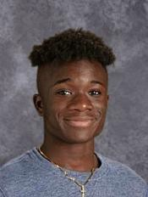
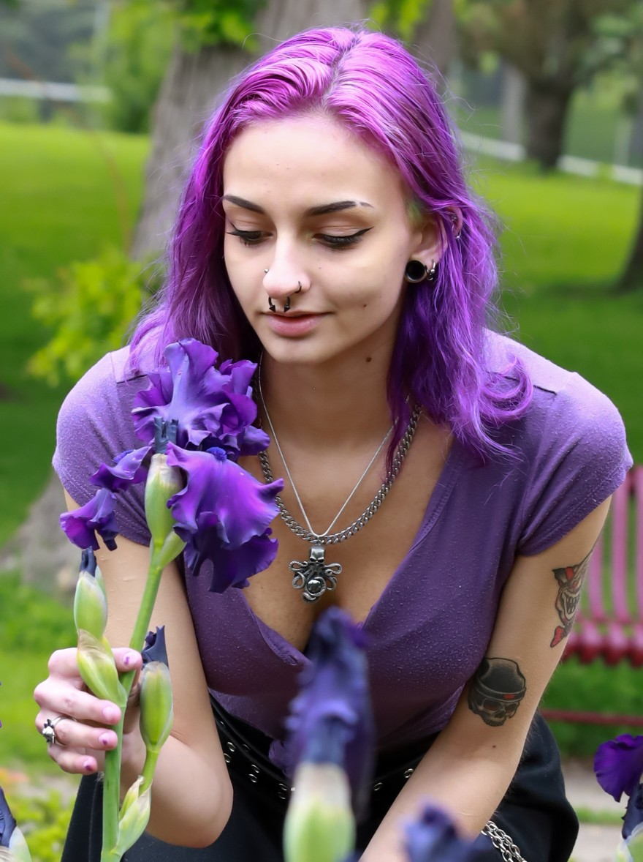
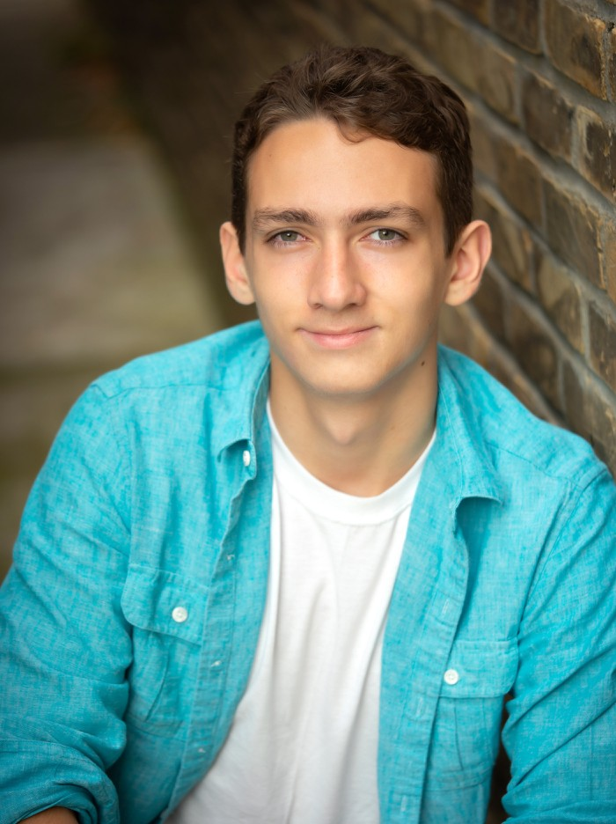
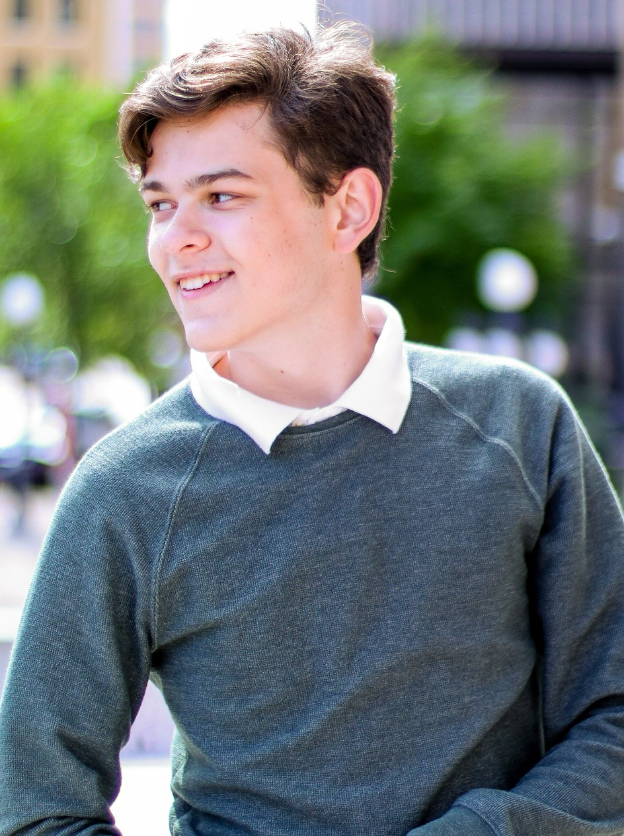
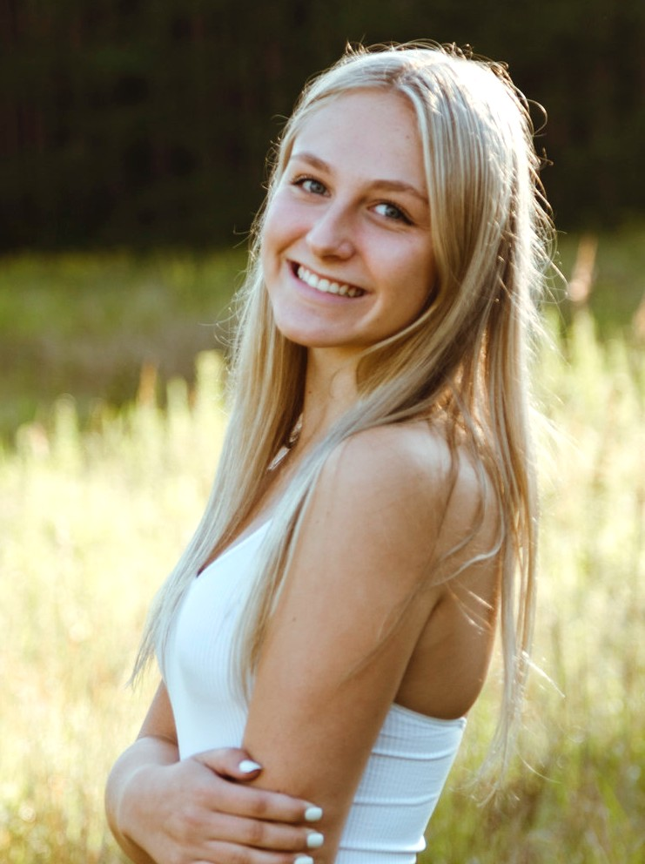
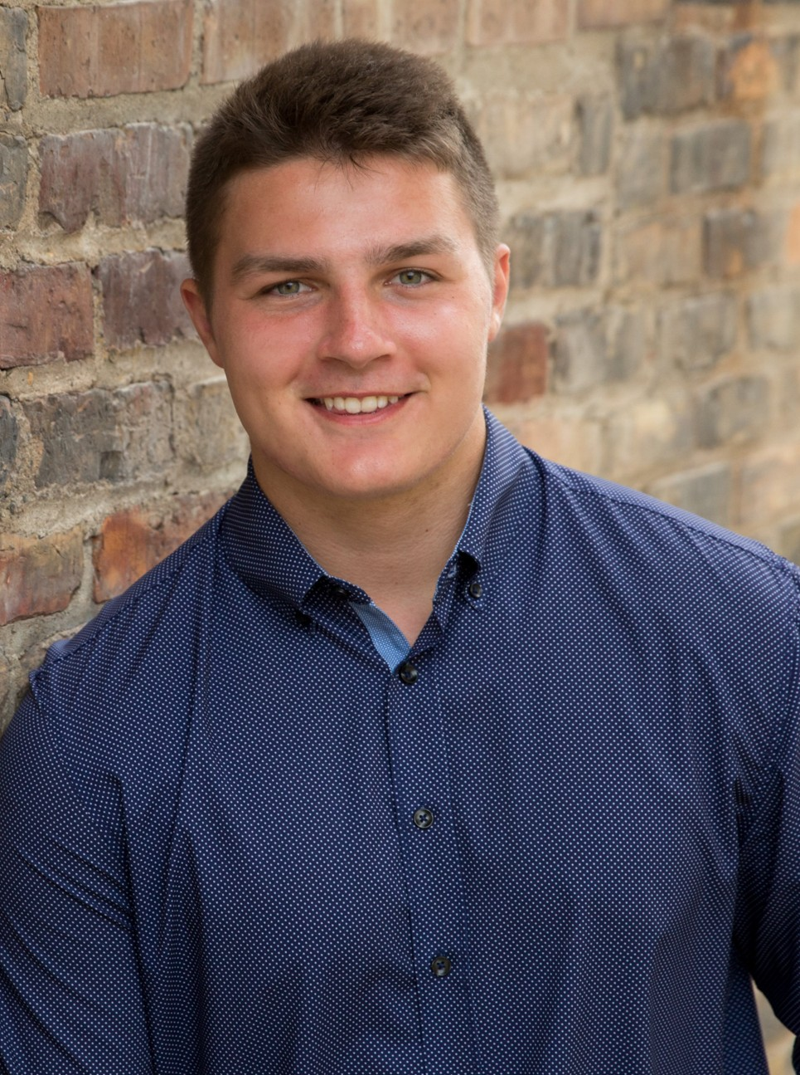
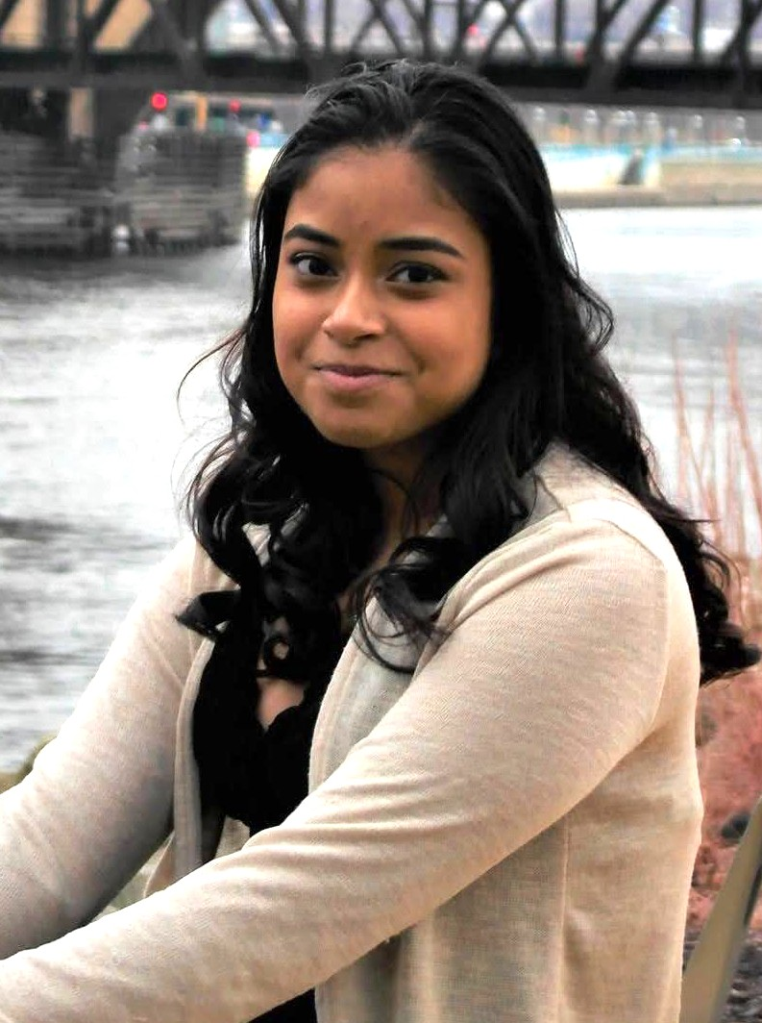
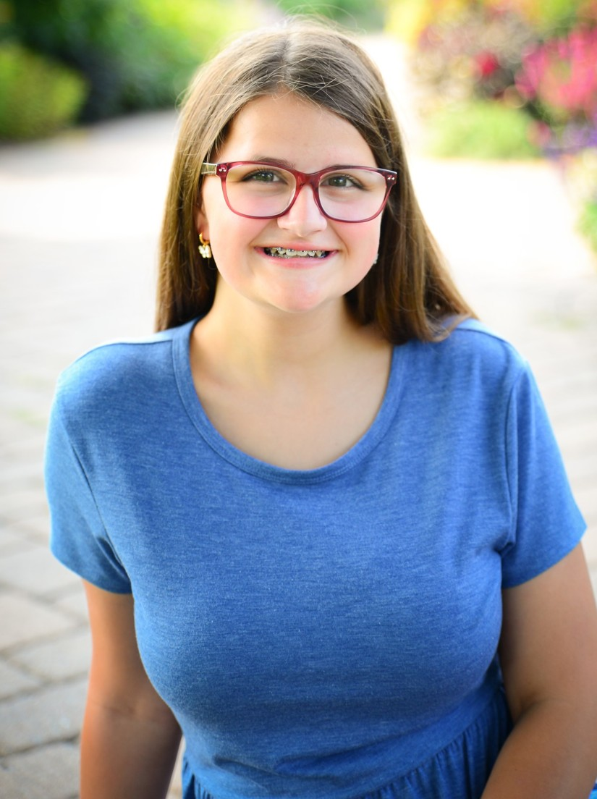
Gabriel Afram sang in Cantemus, Vivace, Da Capo, and Concert Choir. His favorite high school memory is the state track and field meet in 2019. Gabriel hopes to continue with track and field after high school and wants to become a teacher. He wants to thank one of his friends from his sophomore
Samira Awad sang in Cantabile, Cantabile Chamber Ensemble, Bel Canto, Da Capo, Aurora, and Concert Choir. She also participated in numerous theatre productions both as a performer in OnStage, musicals, and plays, and as a member of the tech crew.
Samira’s favorite memory is singing
year who really taught him how to
the opener in OnStage 2019. After
be a better person, and his advice to younger students is “Never give up and don’t listen to what anyone says, because let’s be real: not everyone is as cool as they seem, and we are cooler than we take ourselves for.”
high school, she plans to study audio production at Hennepin Technical College.
Charlie Banta sang in Cantemus, Vivace, Da Capo, Luminos, and Concert Choir. He was also in Tri-M Honor Society and performed in OnStage this year (his favorite high school memory). Outside of the arts, Charlie was a member of the boys’ swim team. He plans to begin his college journey at Inver Hills CC.
Ryan Armstrong sang in Concert Choir this year, his first and last year of choir. He was also active in theatre and band, performing in OnStage, Shrek the Musical, and Marching Band, and working on the tech crew. Ryan plans to pursue a BFA in Acting at the University of Minnesota–Duluth. He wants to thank all the teachers in the
Charlie’s advice to younger
students is “Never tell yourself you’re not ready to do something, because in truth, there are some things where you’ll never be completely ready. And if you never will be, you might as well just do it anyway.”
performing arts department for providing such great opportunities for students.
Syd Ausen sang in Cantabile, Bel Canto, and Concert Choir. She will attend MSU–Mankato and plans to study psychology. Syd wants to thank her mom for always pushing her to do her best, and for being her biggest fan, supporter, and her rock through everything. Syd’s advice to younger students is to stay on top of your schoolwork, but
Charlie Barnick sang in Cantemus, Vivace, and Concert Choir. He also played football and competed in track and field. His favorite choir memory is singing with his brother at the holiday concerts. Charlie will attend Gustavus Adolphus College to study business and play football. He advises younger students in the choral program to make the most of
don't forget that you have just four short years of high
their time in choir, and he thanks his parents for always being there for him and having faith in him.
school — so do what YOU want to do, have fun, join clubs and activities, and most importantly find friends that make you happy and push you to be the best version of yourself.
Ahilya Bharrat sang in Cantabile, Cantabile Chamber Ensemble, Bel Canto, Da Capo, Aurora, and Concert Choir. She was also active in Tri-M, OnStage, theater and event tech, Spanish National Honor Society, speech, and debate.
Ahilya’s favorite choir memories are the Bel Canto trip to Chicago and
Katie Austin sang in Cantabile and Bel Canto. Her favorite choir memory is the Chicago trip with Bel Canto her sophomore year. She was also heavily involved in the theatre program and did tech for every theatre production during her four years at RHS. Katie will attend the University of Wisconsin–
singing at Shepherd of the Valley
Lutheran Church with Dr. Andrew Last. After graduation, she will pursue a Bachelor of Science degree in Health Science on the pre-medical track at the University of Minnesota–Rochester. Ahilya wants to thank her best friend Jenna for being by her side.
Eau Claire to pursue a degree in
English education. She wants to thank Mrs. Toso for always being there for her students.

Slide 15
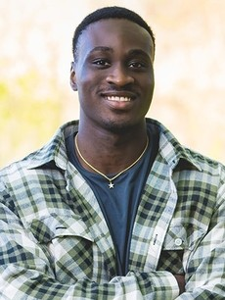
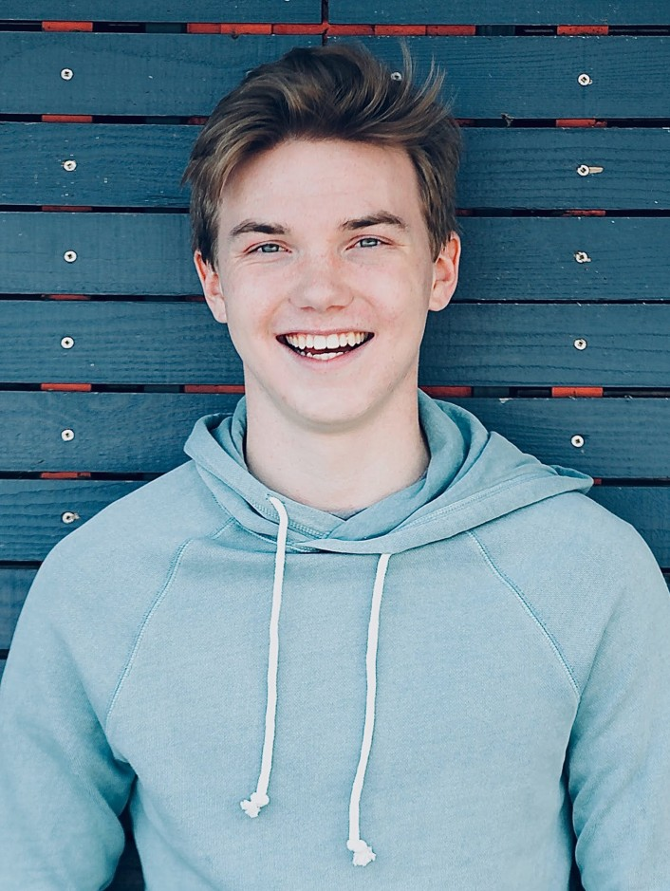
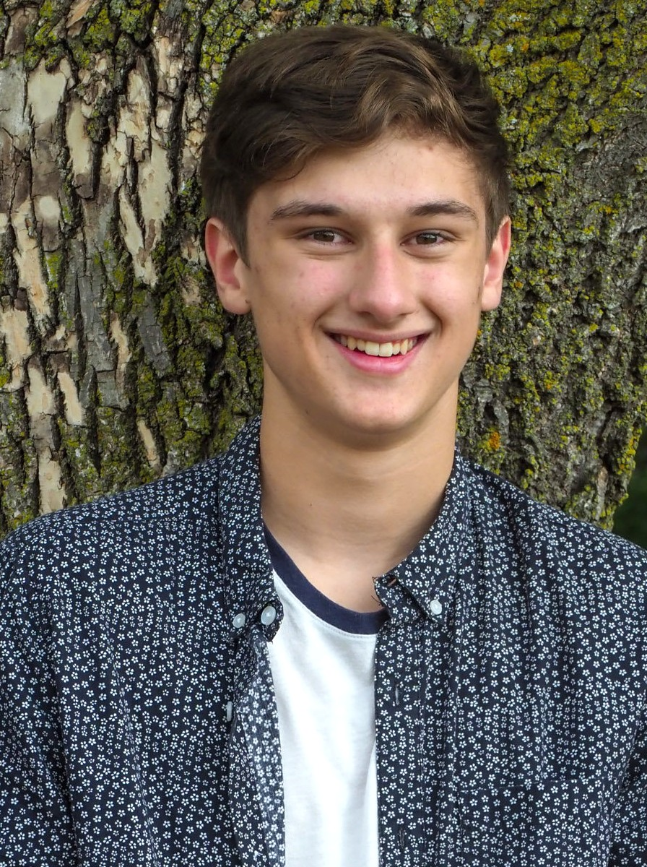
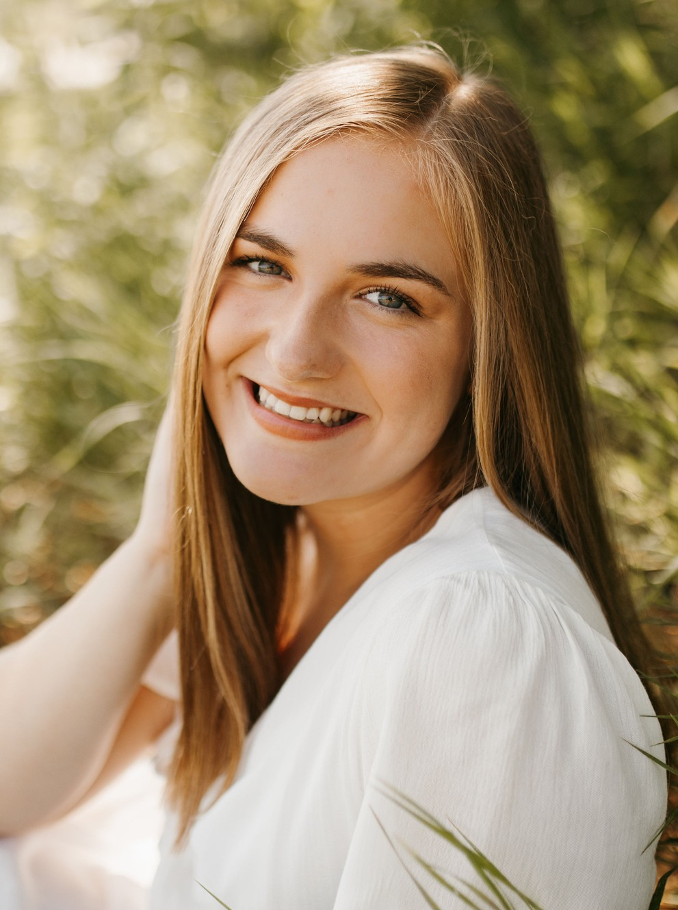
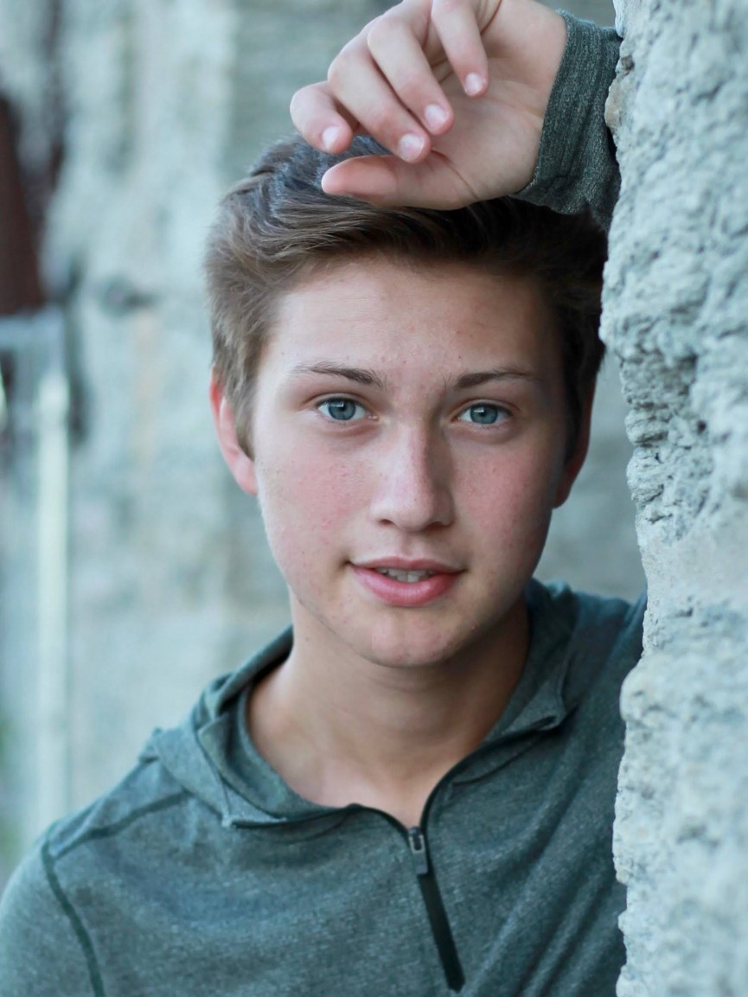
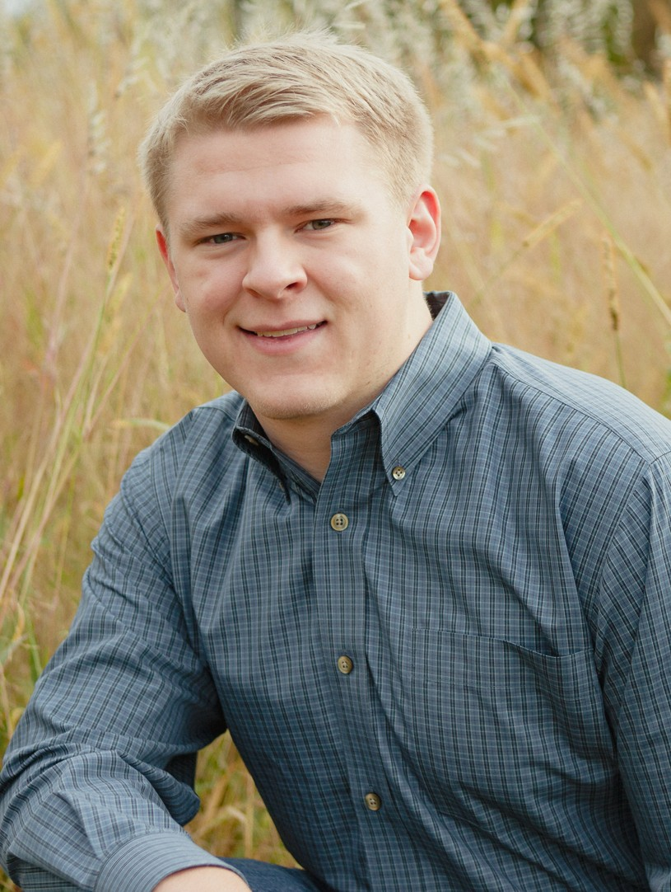
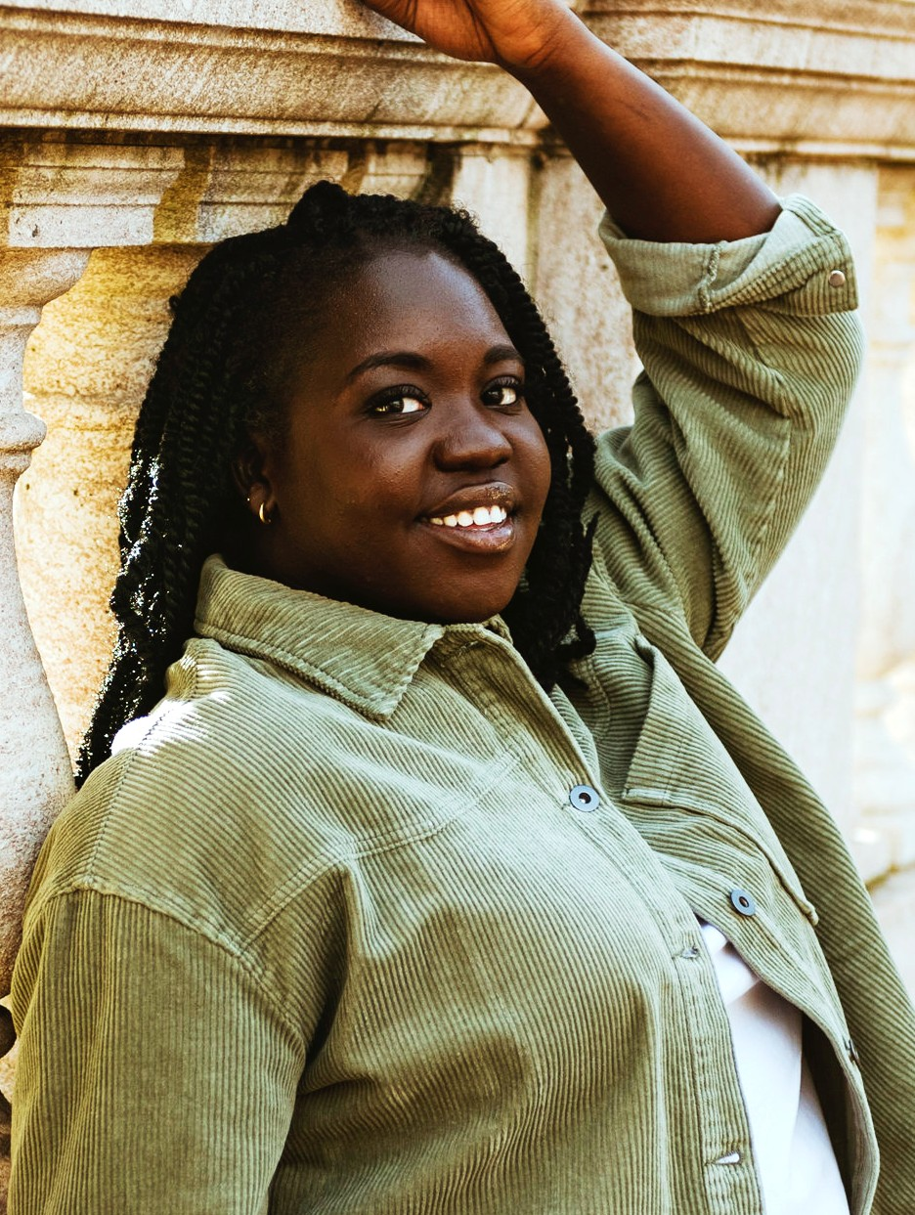
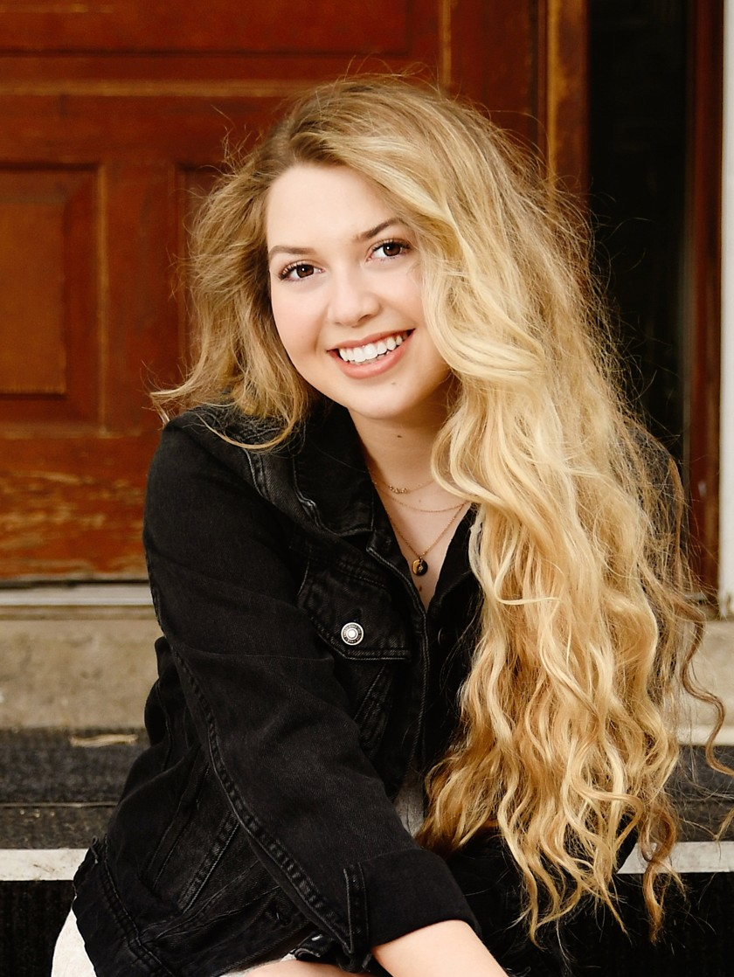
Brian Boakye-Ansah sang in Cantemus, Cantemus Chamber Ensemble, Vivace, and Concert Choir. He was also active in football, basketball, and track. Brian looks forward to studying business administration at the University of Minnesota while also running track for the Gophers. His parting advice
Ethan Christensen sang in Cantemus, Vivace, and Concert Choir. He also performed in OnStage, which is his favorite high school memory. Ethan plans to attend St. John’s University and is currently undecided about a major. He advises younger students to make the most of the time you have
is to enjoy every moment of high
in high school, and thanks his
school, because it really does go by very fast.
parents for making him the person he is today.
Henry Buck sang in Cantemus, Cantemus Chamber Ensemble, Vivace, Da Capo, Luminos, Chamber Singers, and Concert Choir. He is a two-year member of the Minnesota All-State Choirs and was selected for Regional Honor Choir his junior year. He also played soccer for three years and
Claire Chumbley sang in Concert Choir, Da Capo, and Aurora. She was also in Marching Band, Jazz Band, OnStage, Tri-M Honor Society, National Honor Society, and Spanish National Honor Society, and participated in Science Olympiad and golf. Claire plans to study exercise science on a pre-
performed in OnStage every year of
physical therapy track at Loyola
high school. Next year he plans to take a gap year and make music. Henry thanks his parents, his first music teachers, for encouraging his passion for music and supporting him in everything he does.
University in Chicago. Her favorite choir memory is the Concert Choir lock-in her junior year, because it was the first time everyone met and sang together. She thanks Mr. A for encouraging her to join curricular choir when she had only been in OnStage and co-curricular choir.
Guyal Buckley sang in Cantemus, Cantemus Chamber Ensemble, Vivace, Da Capo, Luminos, Chamber Singers, and Concert Choir. He also performed in OnStage, musicals, plays, and the dance show, and was a member of Tri-M Honor Society. His favorite high school memory is being voted
Joshua Cobian sang in Cantemus, Cantemus Chamber Ensemble, Vivace, Da Capo, Luminos, Chamber Singers, and Concert Choir. He also participated in OnStage, Tri-M, NHS, and German National Honor Society, and was captain of the swim team. His favorite choir memory is the Concert Choir lock-in his junior
an Irish Royal by his peers. Guyal
plans to study mechanical engineering at UW–Stout. His parting advice to younger students is not to limit yourself and to try out for everything you can, because the fun you’ll have and the friends you’ll make when you step outside your comfort zone will enrich your life immensely.
year. Joshua plans to study computer engineering at
UW–Madison. He advises younger students to be confident, and remember they’re here for a reason. He thanks Mr. A for inspiring him to make singing such a huge part of his life.
Mercy Bullen sang in Cantabile, Cantabile Chamber Ensemble, Bel Canto, and Concert Choir, and participated in OnStage, Tri-M, the dance show, Beyonds Hip Hop Dance Team, Inclusivity Club, Prom Committee, and Reimage Student Committee. She will pursue a music degree with a minor in acting at
Sydney Dixon sang in Concert Choir and Aurora. She was also in band, Marching Band, Tri-M, OnStage, and Icettes. Her favorite performing arts memory is OnStage her junior year, especially the number “No Good Deed.” Sydney plans to pursue a musical theatre degree with a minor in arts
Columbia College in Chicago. Her
favorite high school memories are the OnStage and
administration at the University of
Beyonds dance rehearsals and performances. Mercy’s advice to younger students is to take care of yourself, be yourself, and enjoy every single moment, because your high school years pass in the blink of an eye.
Wisconsin–Eau Claire. Sydney is grateful for so many
great memories with friends, and thanks her parents for supporting her and always encouraging her to do what she loves.

Slide 16
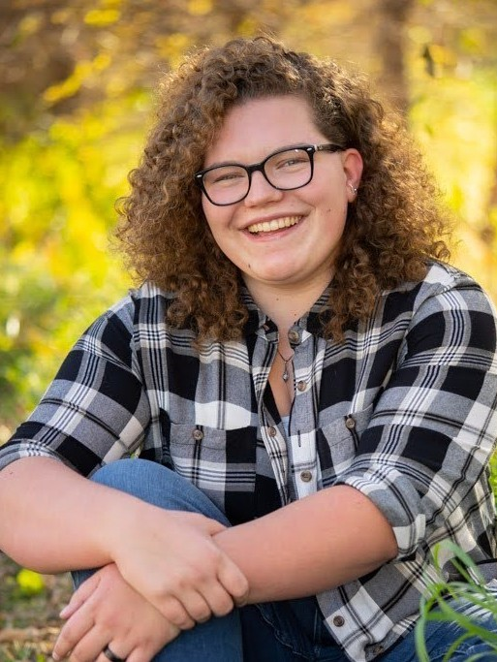
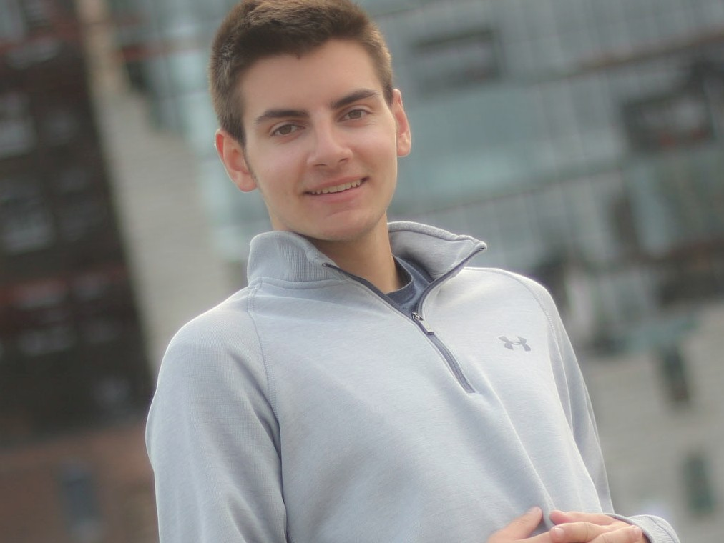
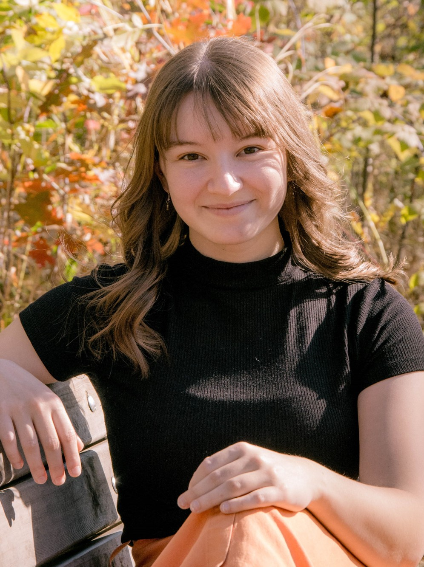
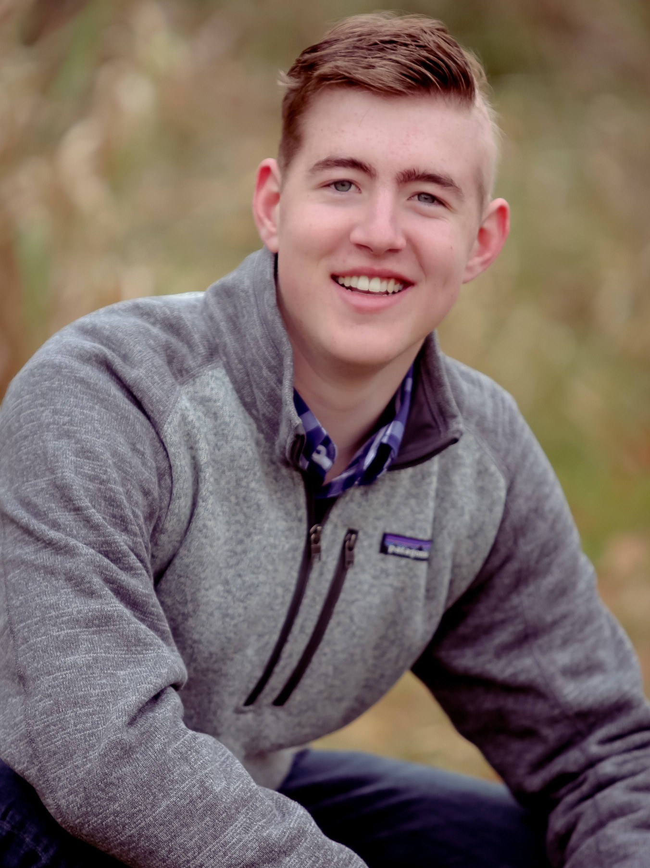
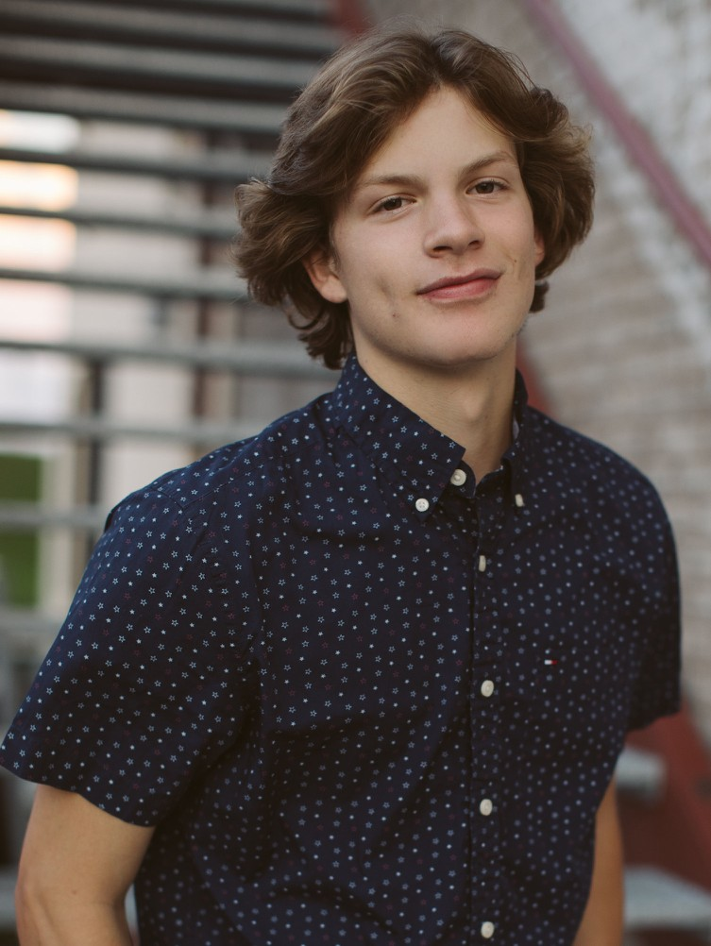
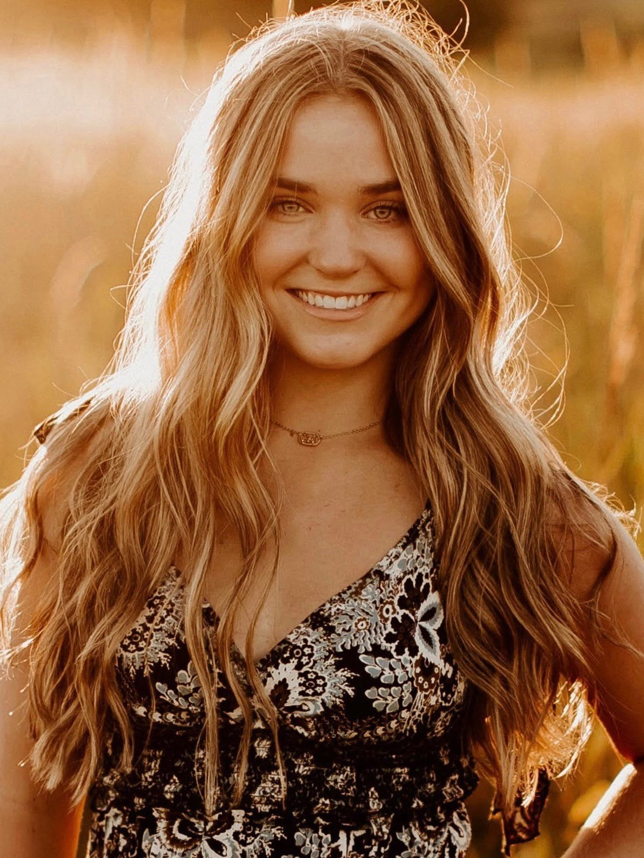
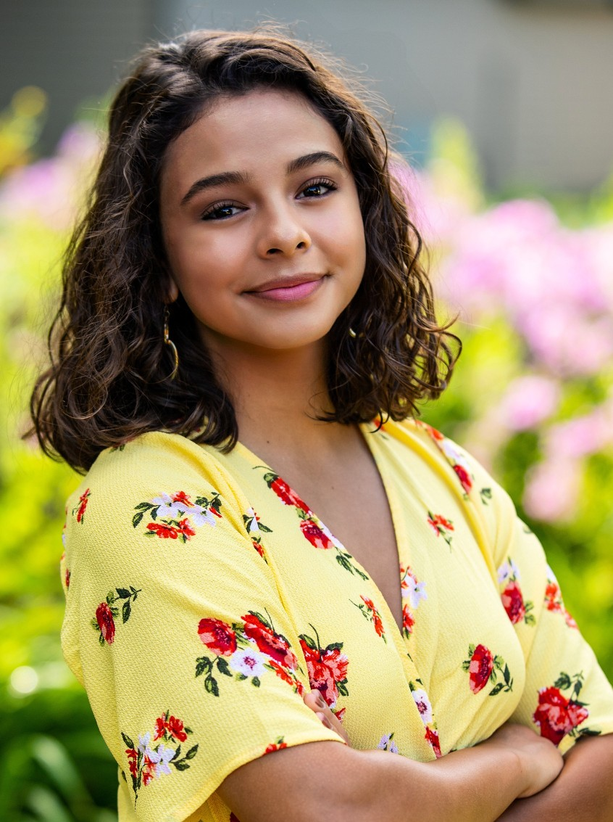
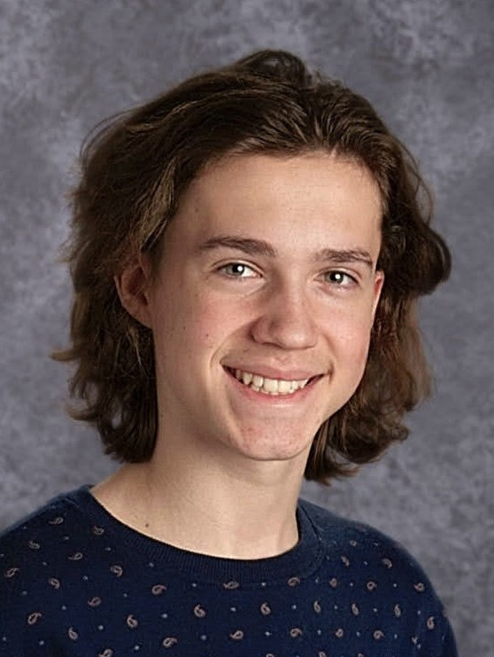
Hailey Gallagher sang in Da Capo, Aurora, and Concert Choir, and also performed in Marching Band, Jazz Band, Wind Ensemble, Pep Band, OnStage, and other theatre productions. Her favorite high school memories came from being involved in all of the arts programs, as they always gave her something
Joey Hall sang in Cantemus, Cantemus Chamber Ensemble, Vivace, Da Capo, Luminos, and Concert Choir. He was also in plays, OnStage, and the musical, and his favorite memories
are of performing live on stage. Joey plans to study
to look forward to. Hailey plans to
environmental science at the University of Minnesota. He encourages younger students to try everything; don’t be afraid to branch out and experience new things.
pursue a double major in psychology and criminology at the U of M–Duluth to. Her parting advice is to participate in everything you can without stretching yourself too thin; you won't regret it!
Heidi Hanson sang in Cantabile, Cantabile Chamber Ensemble, Bel Canto, Da Capo, Aurora, Chamber Singers, and Concert Choir. She was also in Tri-M, NHS, GNHS, and was heavily involved in RHS theatre as a student director, a performer in OnStage and the musicals, and a member of the tech crew. A favorite
Cap George was in choir from the start of ninth grade until the middle of his junior year. He sang in Cantemus, Cantemus Chamber Ensemble, Da Capo, and Vivace.
Cap was also involved in numerous
other school groups and activities including football, basketball, and Student Council. He had a fine tenor voice, a smile that lit up the
(awkward?) memory is when she
asked a student teacher his favorite color. (Turned out, he's colorblind.) Next year Heidi will pursue an English degree at Winona State University. She thanks Mrs. Toso for teaching her that her opinions are wanted, important, and NOT stupid at any time. :’)
room, and a heart big enough to hold everyone. We
were blessed and inspired by his zest for life and his fighting spirit. Though his time here ended far too soon, he left his handprint on all of our hearts, and we will carry him with us always as we go forward into the world.
Robbie Hayes sang in Cantemus, Cantemus Chamber Ensemble, Vox Nova, Da Capo, Vivace, Luminos and Concert Choir. He was also in OnStage and played baseball and basketball. His favorite memory by far is OnStage; he never expected it to be such an awesome experience. Robbie will attend Iowa State University. His parting
Greta Green sang in Cantabile, Cantabile Chamber Ensemble, Bel Canto, Chamber Singers, Aurora, and Concert Choir. She was also actively involved in the dance program, NHS and Tri-M Honor Society, and was a member of the Modern Dance Company. Greta will attend the University of Kansas to earn a degree in elementary
advice to younger students: If you play sports or your
friends think it’s nerdy to be a singer, don’t listen to them. Do what makes you happy. No one is “too cool” to sing!
education with a minor in dance. She reminds everyone to enjoy the little things.
Amber Hernandez sang in Cantabile, Cantabile Chamber Ensemble, Bel Canto, Da Capo, Aurora, Chamber Singers, and Concert Choir. She was also active in Tri-M, OnStage, and solo- ensemble contest. She will never forget the moment when the massed choir started singing with the orchestra at the Dakota Valley
Christopher Guden sang in Vivace and also performed in Marching Band and OnStage. His favorite high school memories are of the time he spent with his friends.
Christopher plans to attend the University of Wisconsin–Madison. He wants to thank his family for
always supporting him.
Choral Festival her junior year. Next year Amber will
begin a degree in English education at UW–Eau Claire. She thanks all the teachers who never gave up on her and helped her when times were hard, and she reminds younger students to get involved and meet as many people as they can.

Slide 17
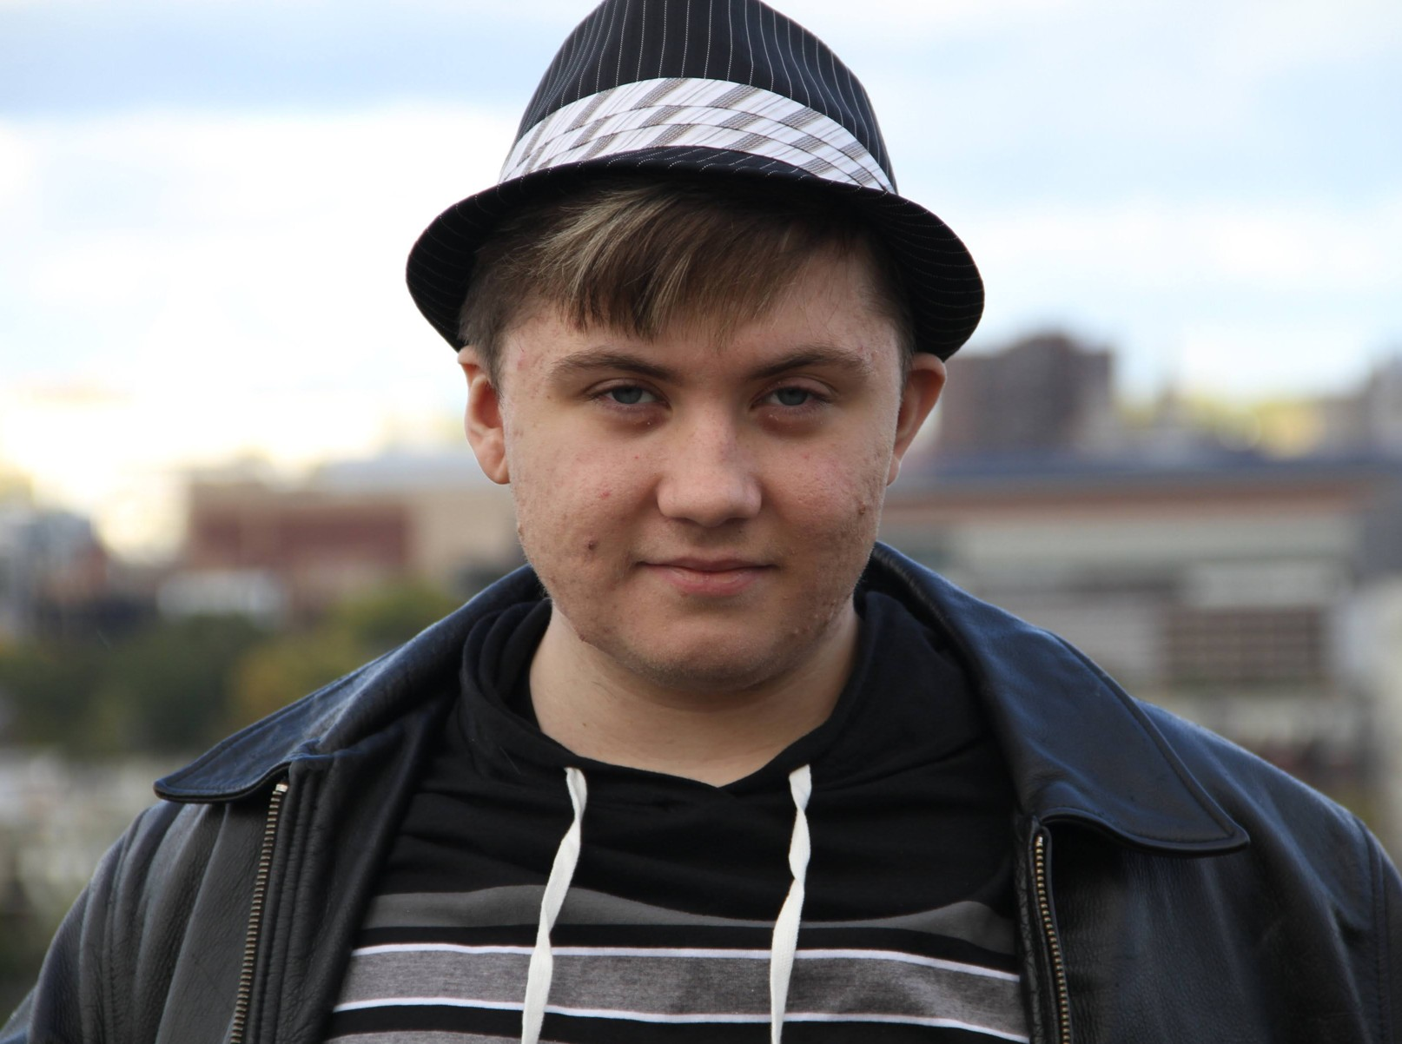
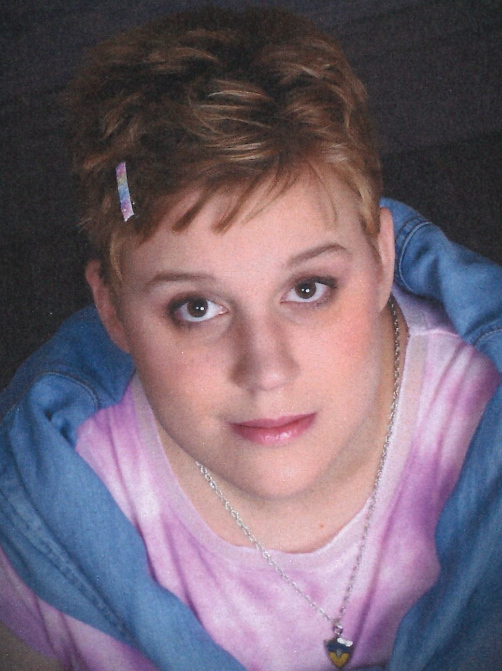
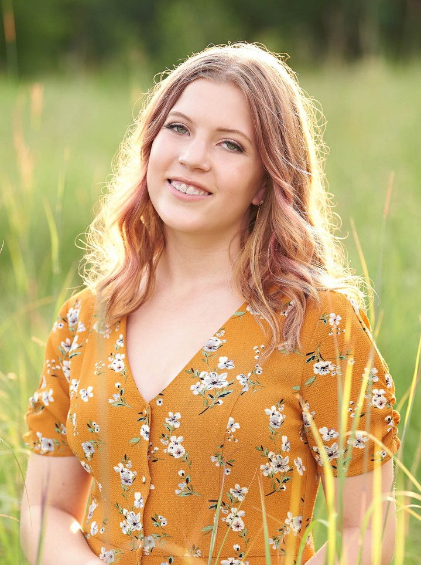
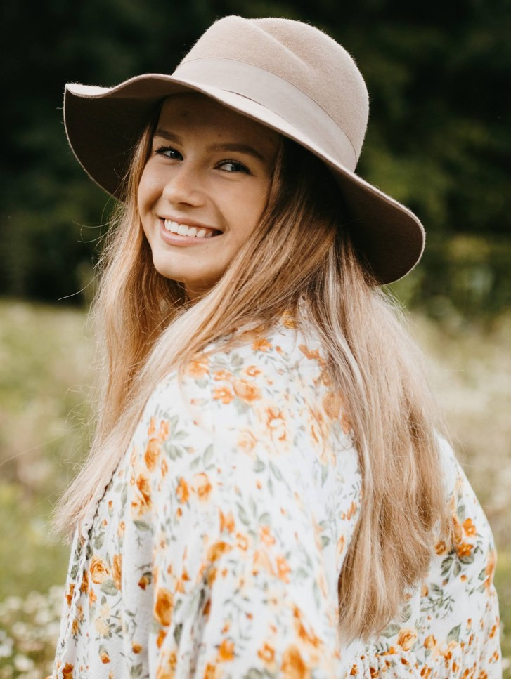
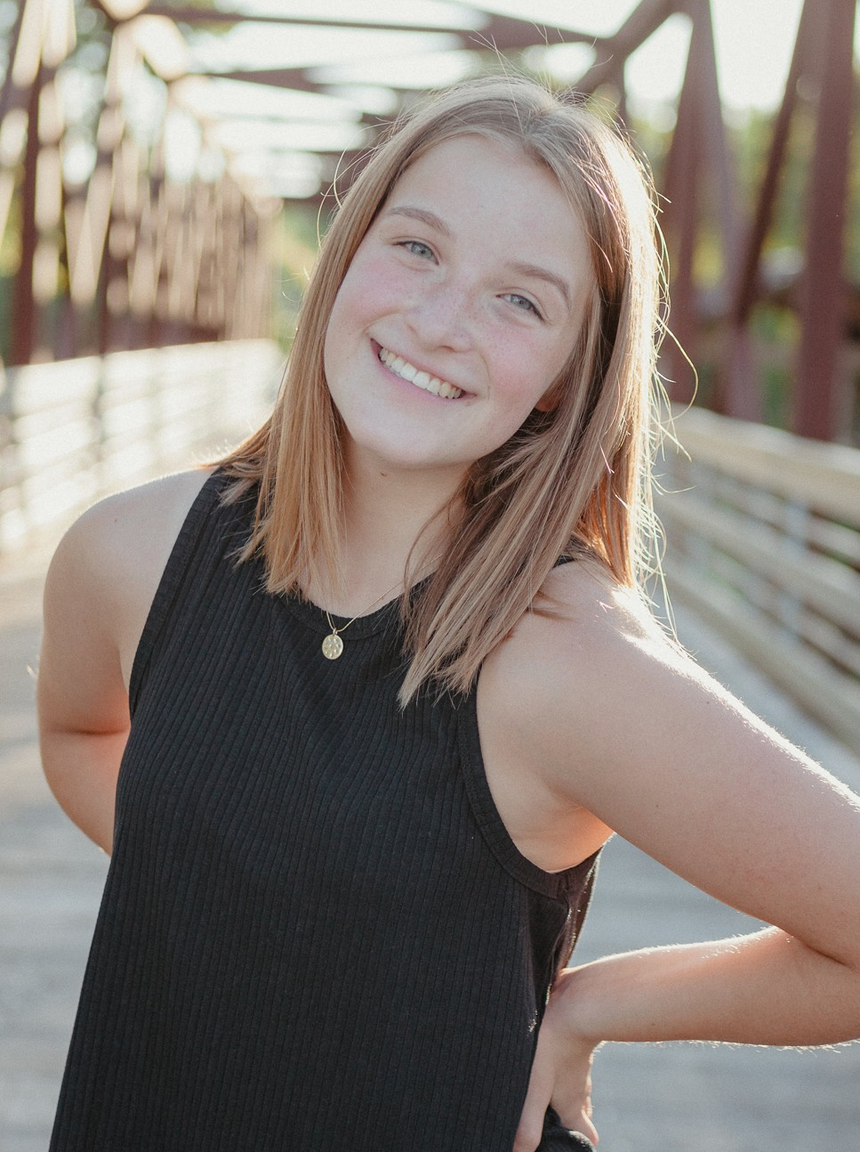
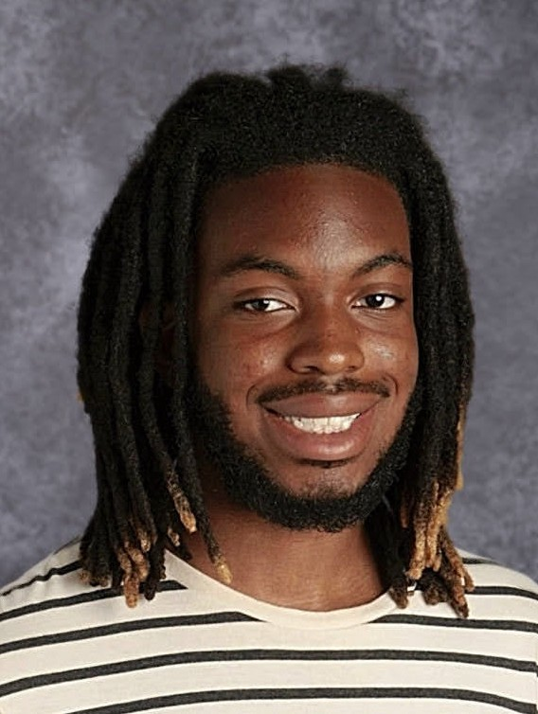
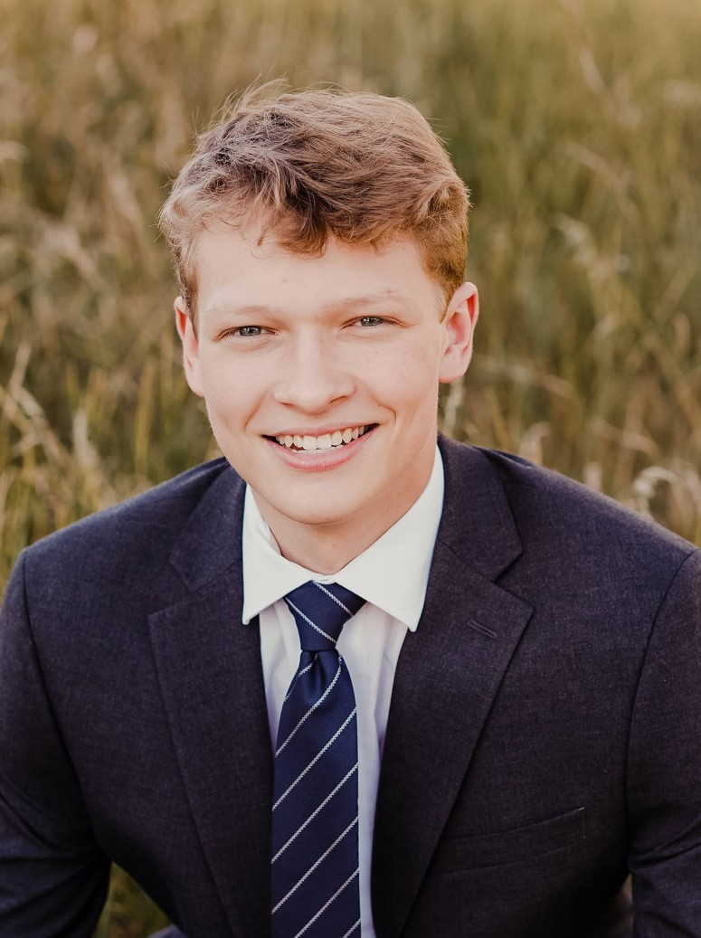
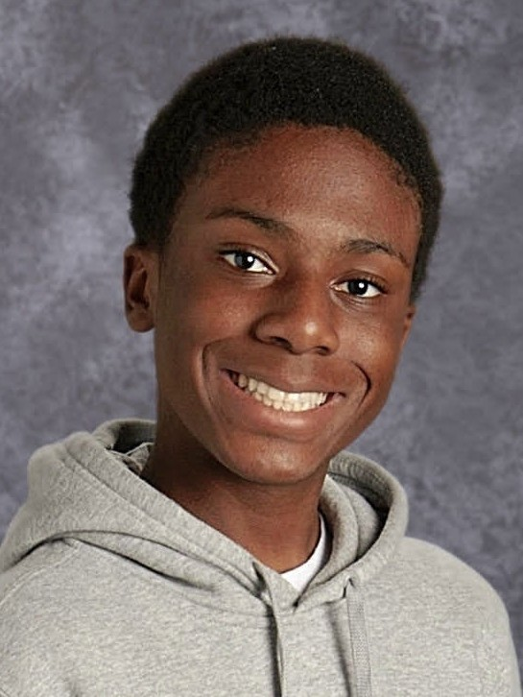
Kyle Hynes sang in Cantemus and Vox Nova, and participated in speech and debate his freshman year. He will start his college career at Normandale Community College and
Maddy Kulbitski sang in Cantabile and Bella Voce. Besides singing, she loves karate, art, and water balloons. Her favorite choir memory is performing in concerts, especially the Showcase concert her sophomore year when she had a solo. Maddy is looking forward to attending Transition Plus next year.
wants to purse writing as a profession. Kyle’s parting
advice to younger students is to remember that even though high school is only one stage of your life, be sure to try your best while you’re here, invest time in what you truly want to do, and don’t be too hard on yourself if you struggle sometimes.
She thanks her friend Deja, her
mom, and her family for encouraging and supporting her.
Danielle Johnson sang in Cantabile, Cantabile Chamber Ensemble, Bel Canto, Da Capo, Aurora, and Concert Choir. She was also active in OnStage, Tri-M, NHS, and French National Honor Society. Her favorite memory is the OnStage productions, where she made so many amazing friends. Danielle plans to pursue a major in
Courtney Landgrebe sang in Cantabile, Bel Canto, Da Capo, Concert Choir, and Chamber Singers. She was also active in Tri- M and OnStage. Her favorite performing arts memory is her first OnStage performance during her junior year. Courtney will attend the University of Minnesota to study political science and Spanish.
biochemistry/biomedical engineering and a minor in
She advises younger students to not be afraid to get out of their comfort zone!
French at Montana State University. She thanks her parents, friends, and teachers, because she wouldn’t be where she is without all of their support.
Rachel Leholm sang in Concert Choir and was also in band, Tri-M Honor Society, and OnStage.
Additionally, she was active in girls’
swimming and diving, NHS, and Spanish National Honor Society. Her favorite memory is the closing night performance of OnStage.
Rachel will attend Iowa State University and plans to study
Jaden Johnson sang in Cantemus, Vox Nova, and Vivace, and his favorite memory from choir is the field trip to St. Olaf. He plans to take a gap year to figure out what he wants to study in college.
Jaden’s advice to younger students is not to get distracted, stay focused on what you want to
chemical engineering. She reminds younger students to be open to anything and everything, because you’re never too cool to have fun.
accomplish and keep working
toward your goals. He gives special thanks to his old friend Gavin, and he’s sorry he never got to say goodbye to him when he moved away.
Luke Levandowski sang in Cantemus, Vox Nova, Vivace, and Concert Choir. He also plays hockey. Luke plans to play in the USHL with the Chicago Steel. After the USHL, he plans to attend the University of Wisconsin–Madison to pursue a degree and play hockey. He thanks Ms. Sandham for putting
Kezelee Jones sang in Concert Choir and was also involved in OnStage and Marching Band. His favorite performing arts memories are of dancing with his friends and marching at Super Regionals in Indianapolis. Kezelee plans to pursue a degree in secondary education and teach biology. His
together his senior bio based on
the caption next to his picture across from the main office.
parting advice: Don’t focus on
being the best, focus on doing your best.

Slide 18
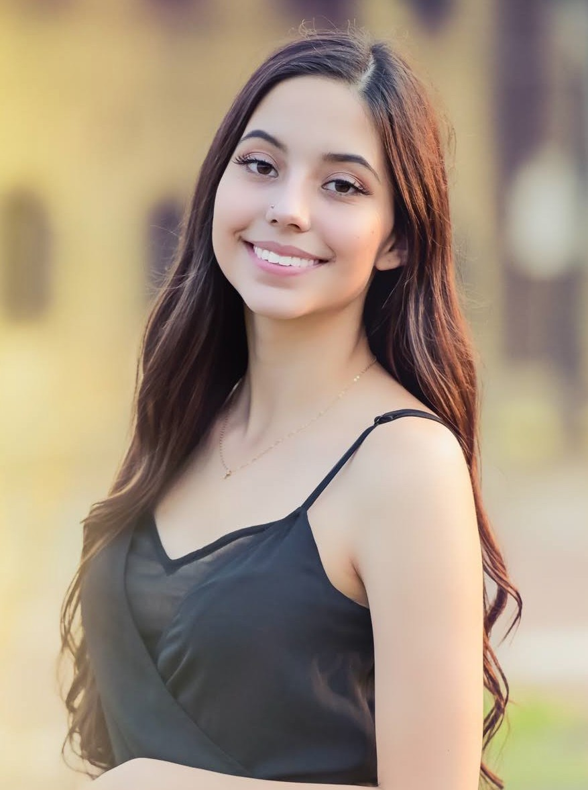
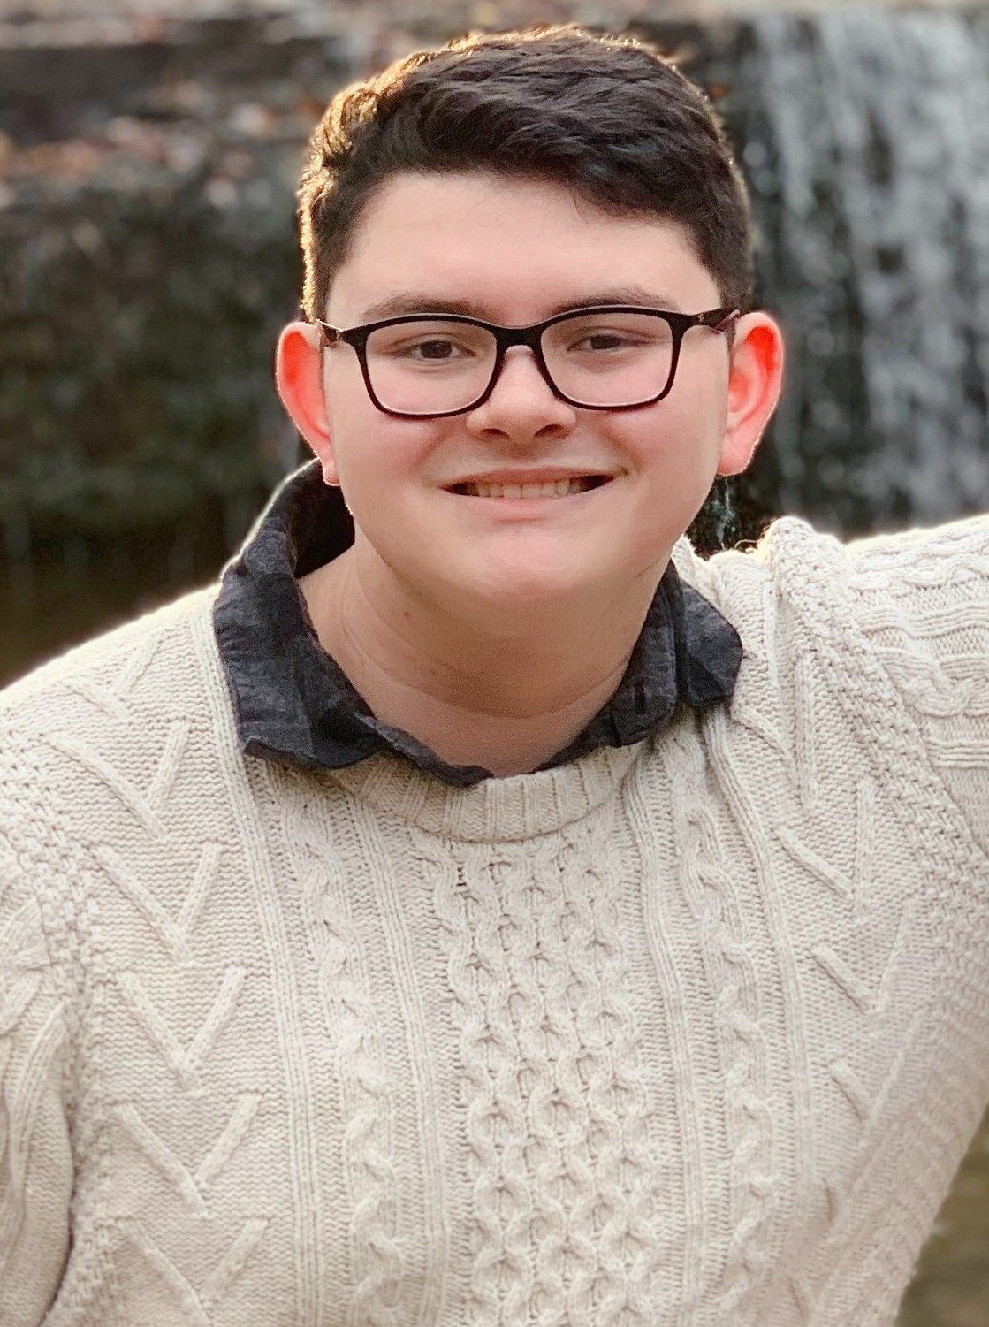
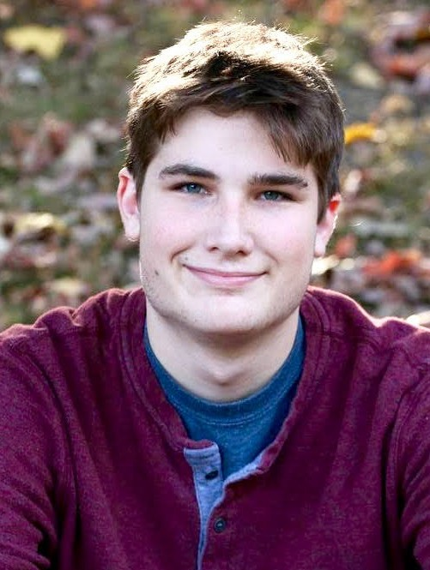
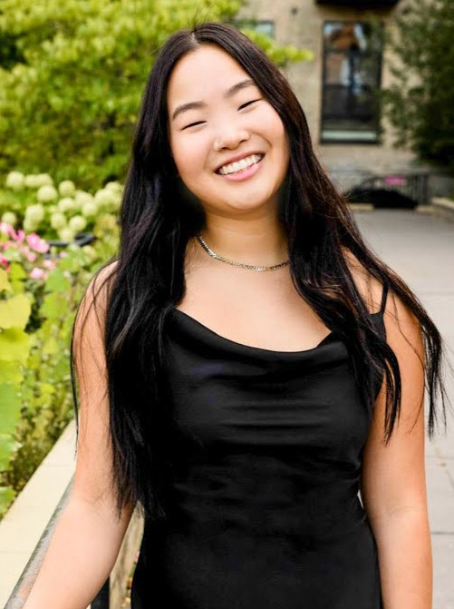
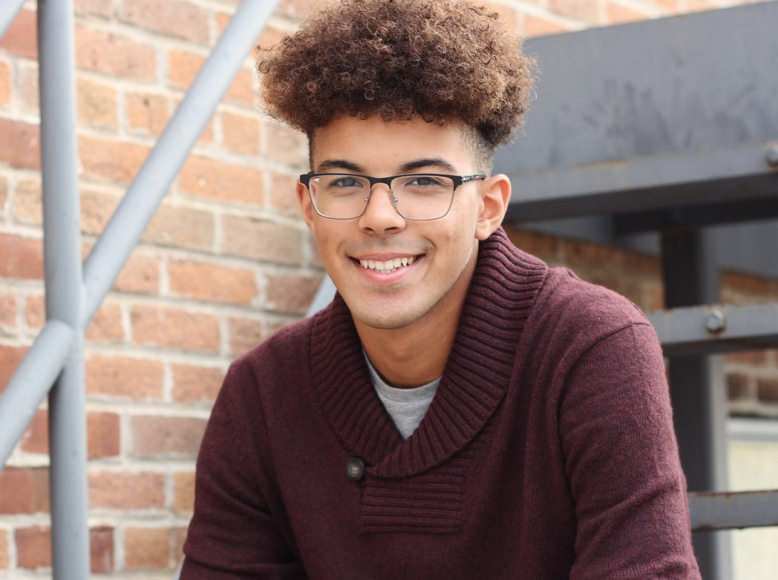
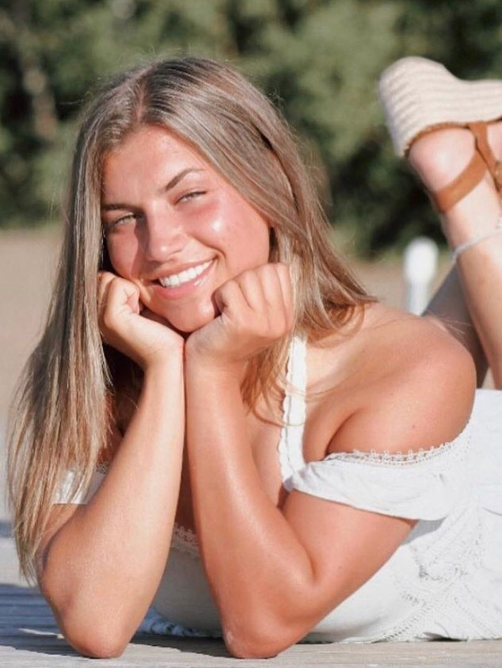
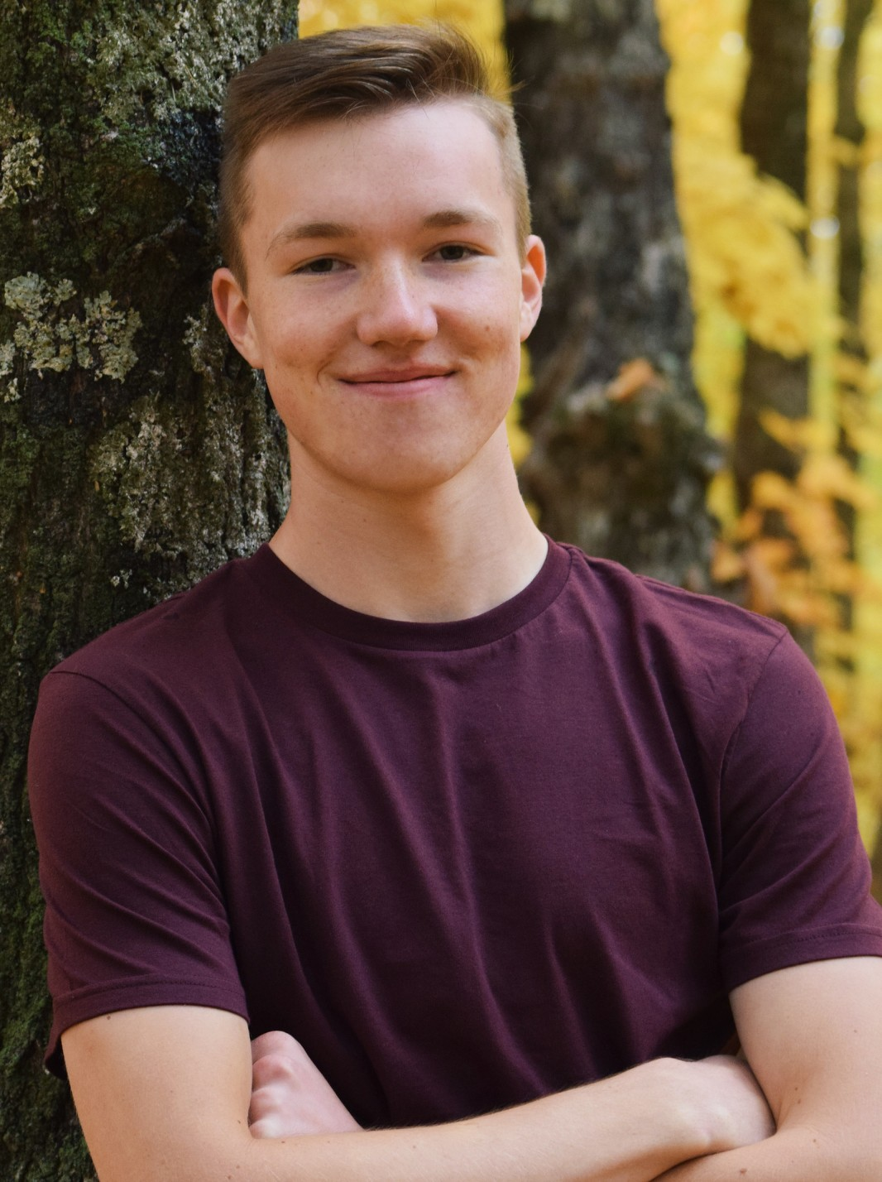
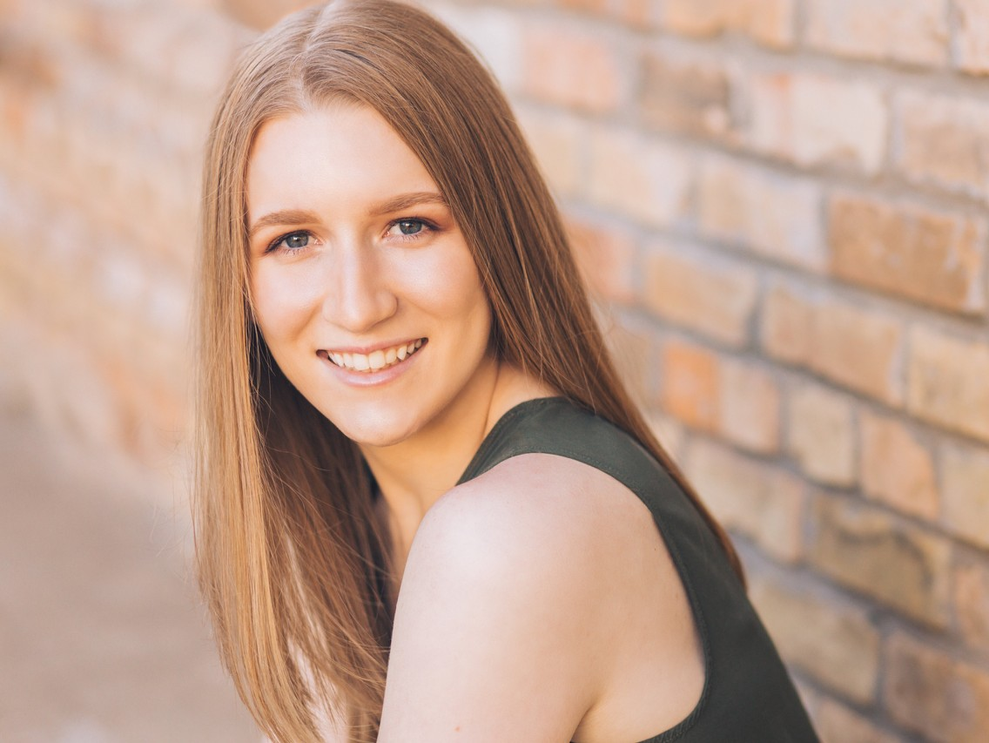
Melissa Mancha sang in Bel Canto and Concert Choir. She also played alto sax in band for two years of high school. Of all her high school memories, the one she cherishes most is her Spanish Heritage class with Ms. Nyseth. Melissa plans to pursue a career as a dental hygienist. Her advice to younger
Alex Nunez sang in Cantemus, Vivace, Da Capo, Luminos, Chamber Singers, and Concert Choir, and he participated in theatre productions during the past two years. Alex was also selected for 9-10 State Honor Choir and All- State Choir. One high school memory that particularly stands out
students is to avoid procrastinating.
is his first Chamber Singers
She thanks her parents for their support.
performance, when he ripped his pants. Alex plans to pursue a teaching career. He extends very special thanks to Mr. Miller and Ms. Sandham.
Easton Milne sang in Cantemus, Vivace, and Concert Choir, and played percussion in band through middle school. He played hockey all four years of high school and now plays volleyball as well. Easton plans to pursue a criminal justice degree at St. Cloud State. His parting advice: School can be a constant source of stress, but things
Pieper Olson sang in Cantabile, Cantabile Chamber Ensemble, Bel Canto, Da Capo, and Concert Choir. She was also in Tri-M Honor Society. Pieper’s favorite choir memory is all the concerts. She plans to start her post-secondary journey at community college and wants to study kinesiology.
usually end up how they’re supposed to; so just take a
breather and focus on doing your best. Easton thanks his parents, friends, family, and all of his amazing teachers.
Ian Morris sang in Cantemus, Vivace, and Concert Choir, and was in band for five years. Among his favorite memories are of the football games and choir concerts. Next year, Ian will
Lexi Orlando sang in Cantabile, Bel Canto, and Concert Choir. She was also a varsity soccer player.
Her favorite high school memory is playing in the state soccer tournament at U.S. Bank Stadium. Lexi plans to attend college at North Central University. She is currently undecided about her major.
head to Montana State University to study mechanical and aeronautical engineering. He advises younger students to do their work and enjoy their time in high
school, because it goes by super, super fast. He is grateful to his parents for their constant support, both for his studies and for all of his outside-of-school endeavors.
Jacob Otness sang in Cantemus, Cantemus Chamber Ensemble, Vivace, Da Capo, and Concert Choir. He also played on the tennis team. His favorite high school memories are of playing varsity tennis and singing in choir. Jake intends to start his college career at a community college and then
Sydney Nelson sang in Cantabile, Bel Canto, Concert Choir. She was also active with Math Team, Science Olympiad and volleyball. Her favorite choir memory is the Bel Canto trip
transfer to a school where he can
to Chicago. Sydney will study mechanical engineering at
earn a four-year degree, though he is not yet sure of his field of study. He thanks all of his teachers for creating a great learning experience!
Iowa State University. Her parting advice is to take advantage of the many amazing opportunities RHS offers.

Slide 19
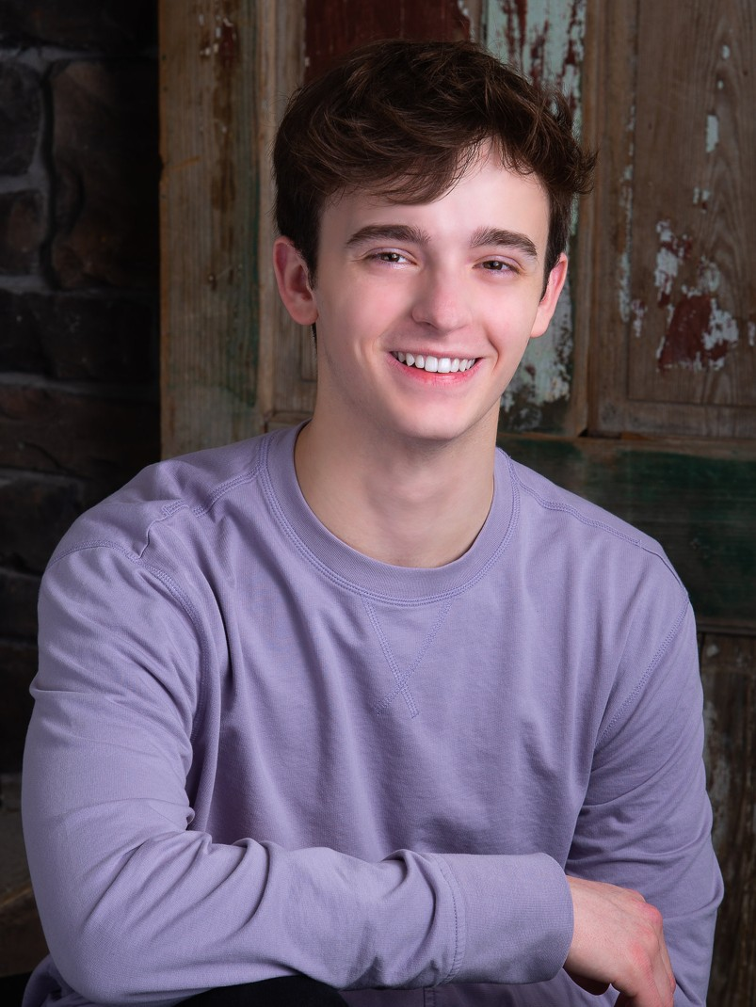
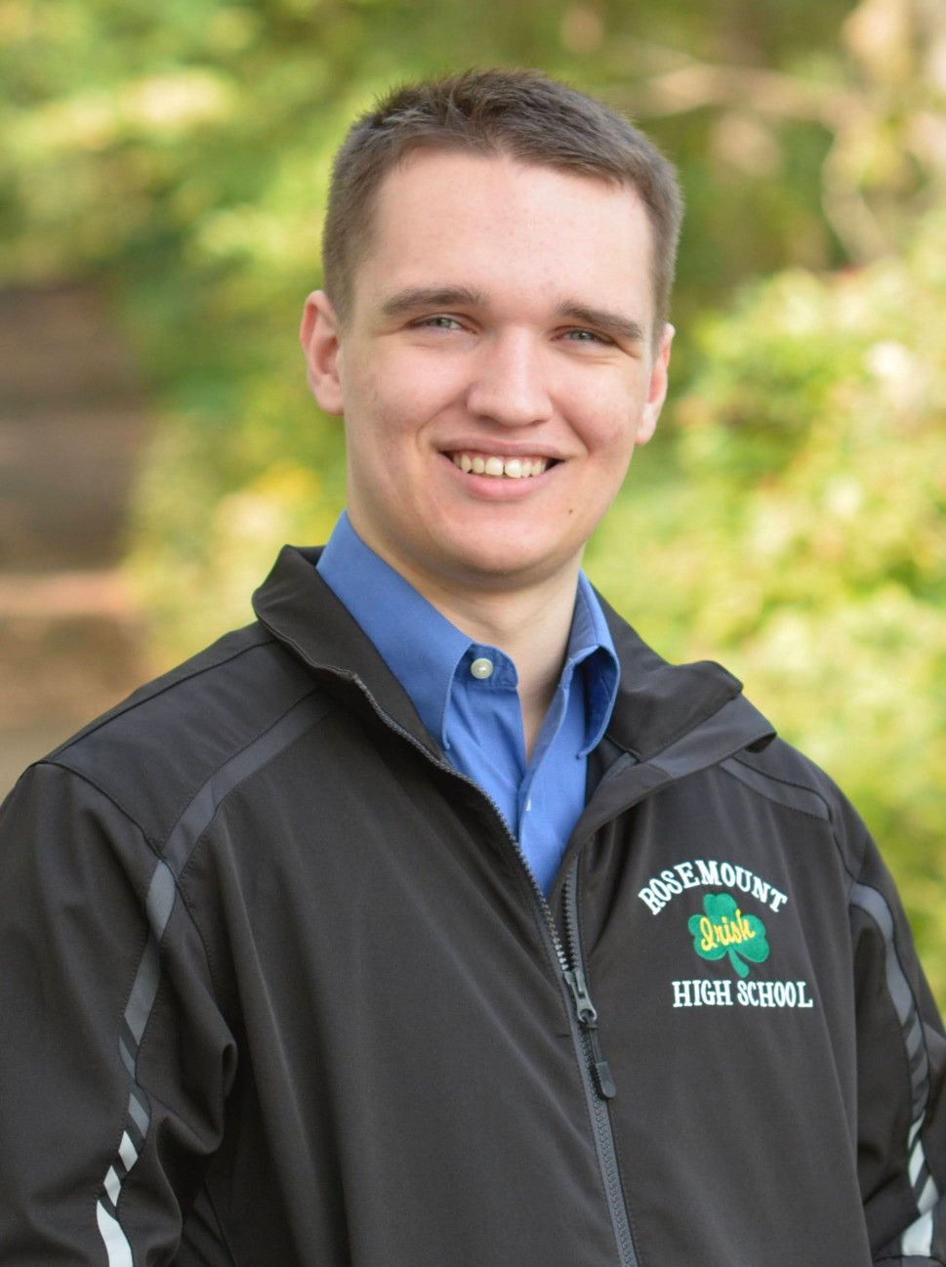
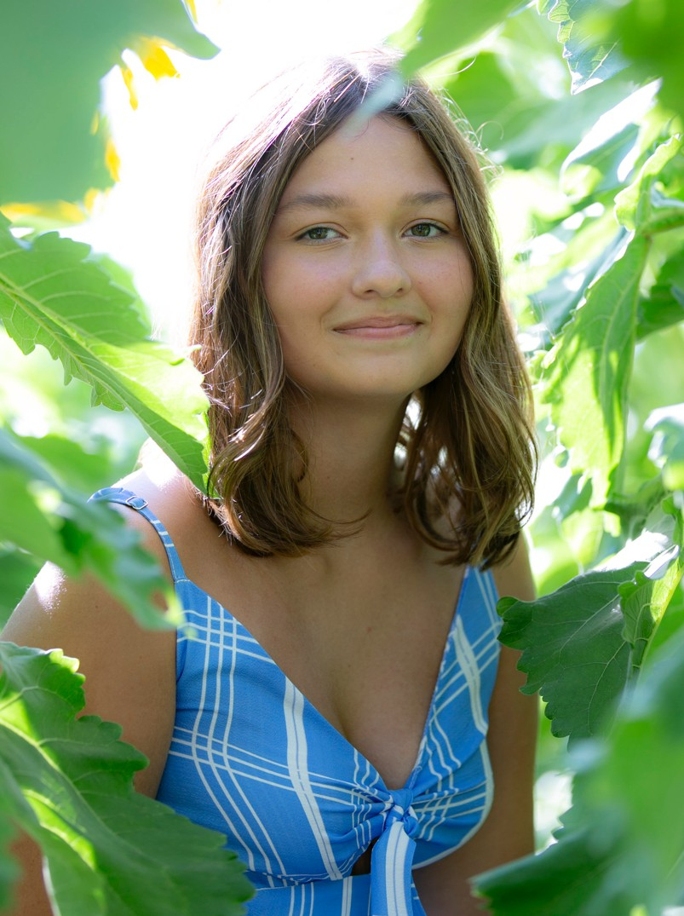
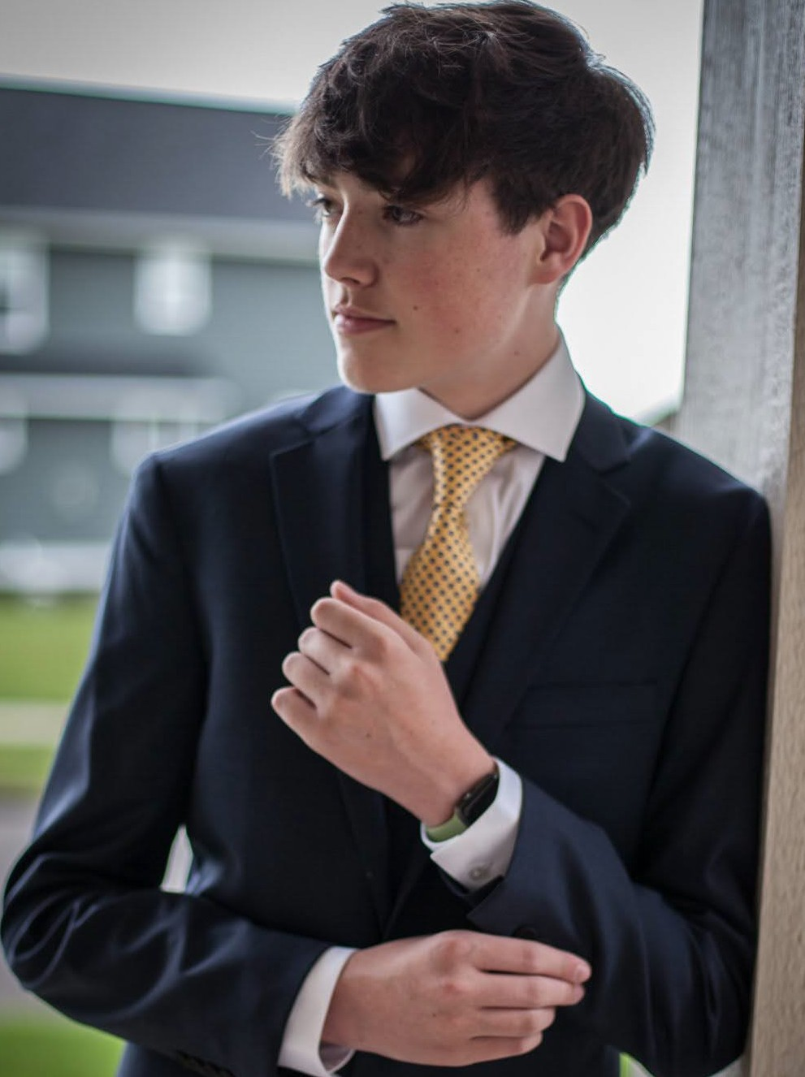
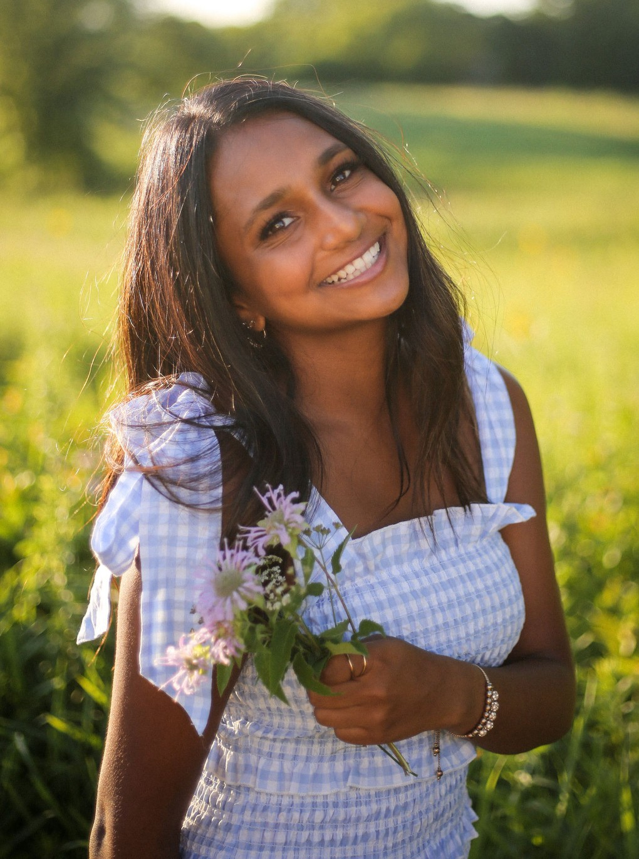
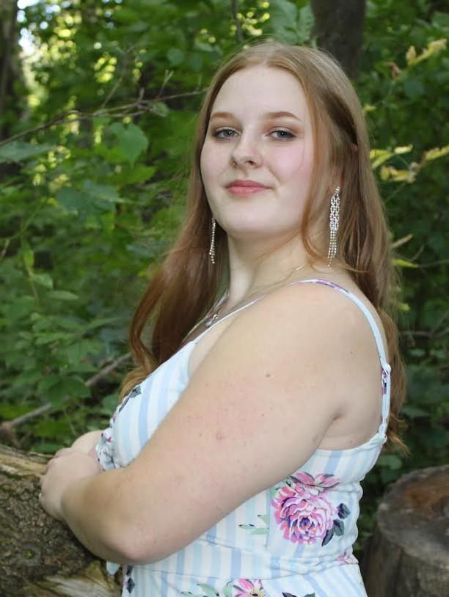
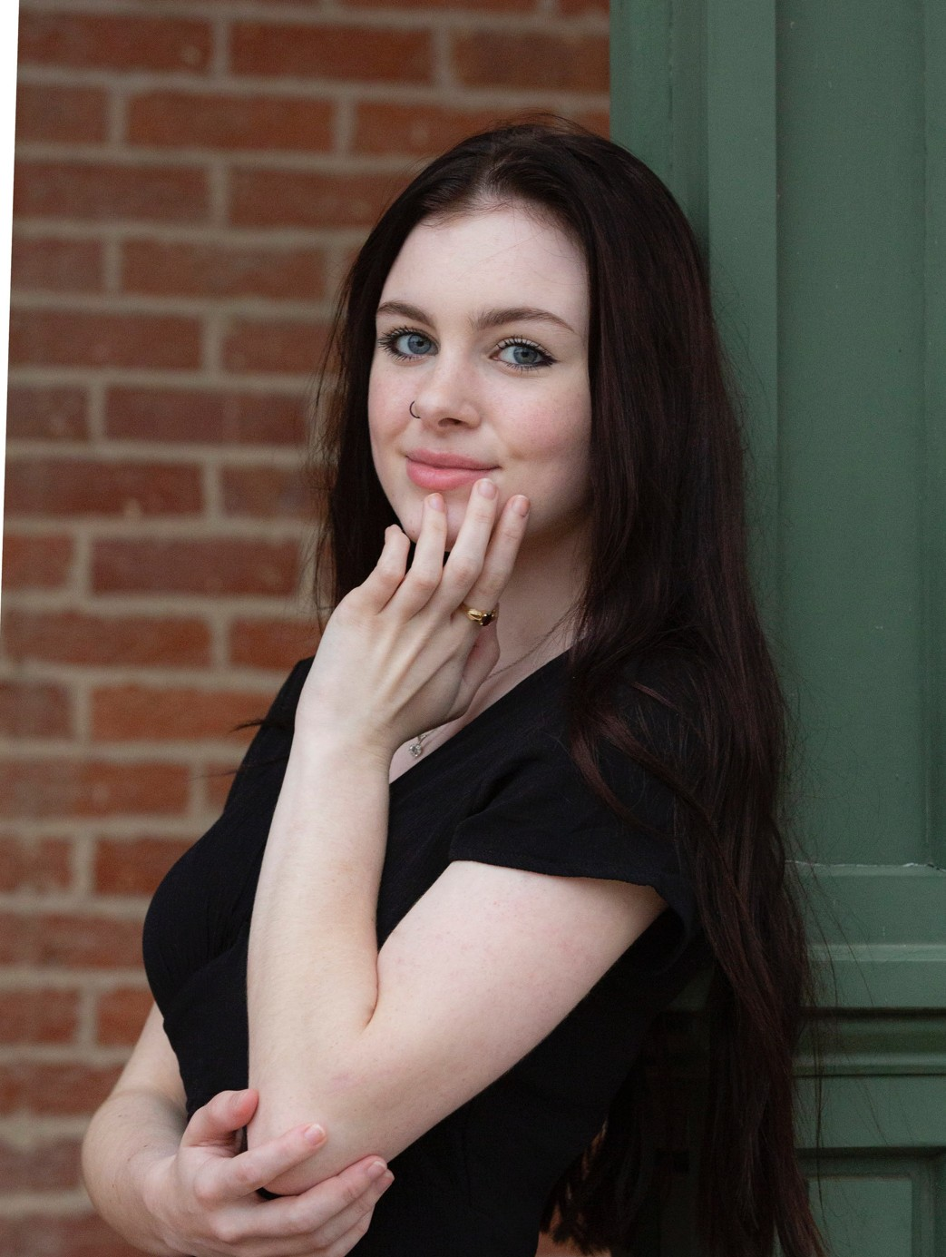
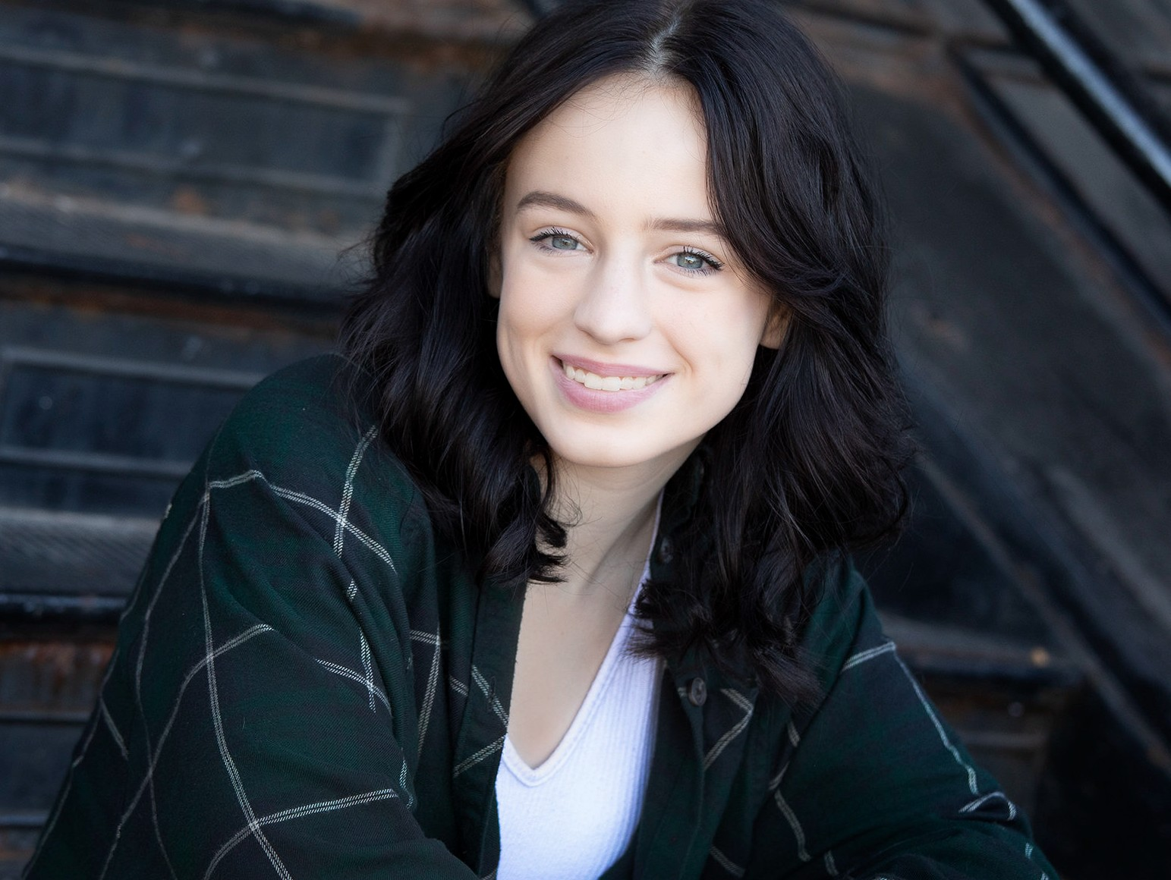
Alex Owens sang in Cantemus, Cantemus Chamber Ensemble, Vivace, Da Capo, Luminos, and Concert Choir, and he also performed in OnStage. He was also selected for 9-10 State Honor Choir and ACDA Regional Honor Choir. Alex plans to attend the University of Florida and study chemistry. To younger students, he says, “Cherish
all of the special little moments, because high school goes by in a flash.”
Conor Quinn sang in Vox Nova and was also involved in swimming and chess. He enjoyed seeing everyone come closer together in class, and is grateful to his first music teacher who got him into singing. (He still remembers some songs from back then.) Conor plans to join the National Guard and
wants to enter the field of cyber
security. He reminds younger students to think of choir as something to de-stress with and to have fun singing together.
Isabelle Pacheco sang in Cantabile, Cantabile Chamber Ensemble, Bel Canto, Da Capo, Chamber Singers, and Concert Choir. She was also in OnStage, musicals, and did tech for plays. Her favorite choir memory is the Bel Canto trip to Chicago. Belle plans to start her college journey at Normandale Community College.
Ian Rambo sang in Cantemus, Da Capo, and Vivace. He also did tech for OnStage and two musicals. Ian will always fondly remember the fourth-floor pool. He plans to take a gap year, then attend a two-year college and see where his interests lead him. He thanks his family for being at his side through everything.
She thanks Ms. Toso for always being there for everyone, and implores younger students to remember that your life in high school shouldn’t revolve just around your grades and what activities you're in. Those aren’t the things you’ll remember 20 years from now.
Sonya Ramesh sang in Cantabile, Bel Canto, Da Capo, and Concert Choir. Additionally, she participated in Tri-M, girls’ varsity tennis, Student Council, and DECA. Sonya’s favorite choir memory is the Bel Canto trip to Chicago. She is looking forward to attending Indiana University’s Kelley School of Business, where she plans to
Savanna Peterson sang in Cantabile, Cantabile Chamber Ensemble, Bella Voce, Da Capo, Aurora, and Bel Canto, and also participated in Tri-M, National Art Honor Society, and theater tech. Her favorite high school memory is when she and a friend got paint all over each other while doing tech for Shrek, The Musical. Savanna will
pursue a degree in information systems.
Abby Riedinger sang in Cantabile, Bella Voce, and Bel Canto. She also played volleyball. Her favorite high school memory is the SES Baker field trip. Abby plans to begin her post-secondary career at Dunwoody Technical College.
start her college journey at Inver Hills Community
College. She thanks her choir and art teachers for encouraging her creativity and supporting her when she struggled. Her parting advice: Be the best person you can possibly be, and don’t let anyone deter you from being your true self.
Charlie Prasil sang in Bel Canto and Concert Choir and was a member of Tri-M Honor Society. She plans to attend MSU and major in aerospace engineering.
Charlie advises younger students to remember that
high school will go by faster than they think, and to do
their best to make wonderful, lasting memories. She thanks Mrs. Toso for helping her become a more confident singer and person.

Slide 20
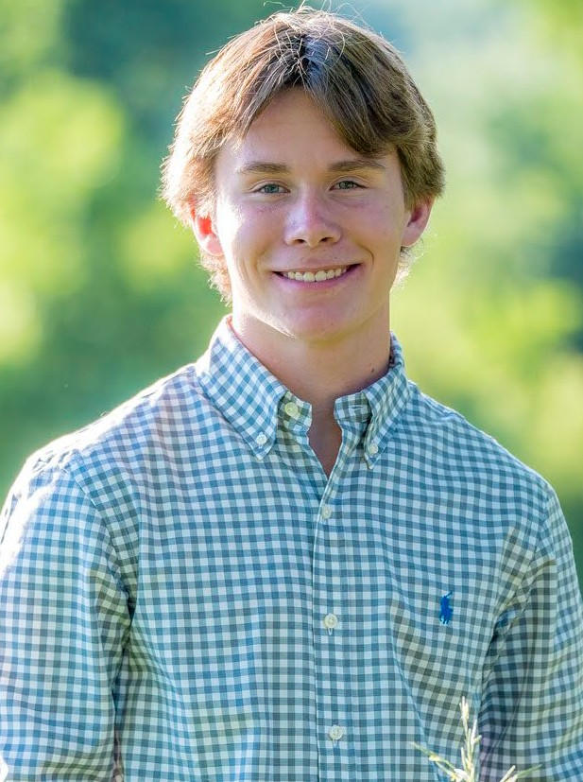
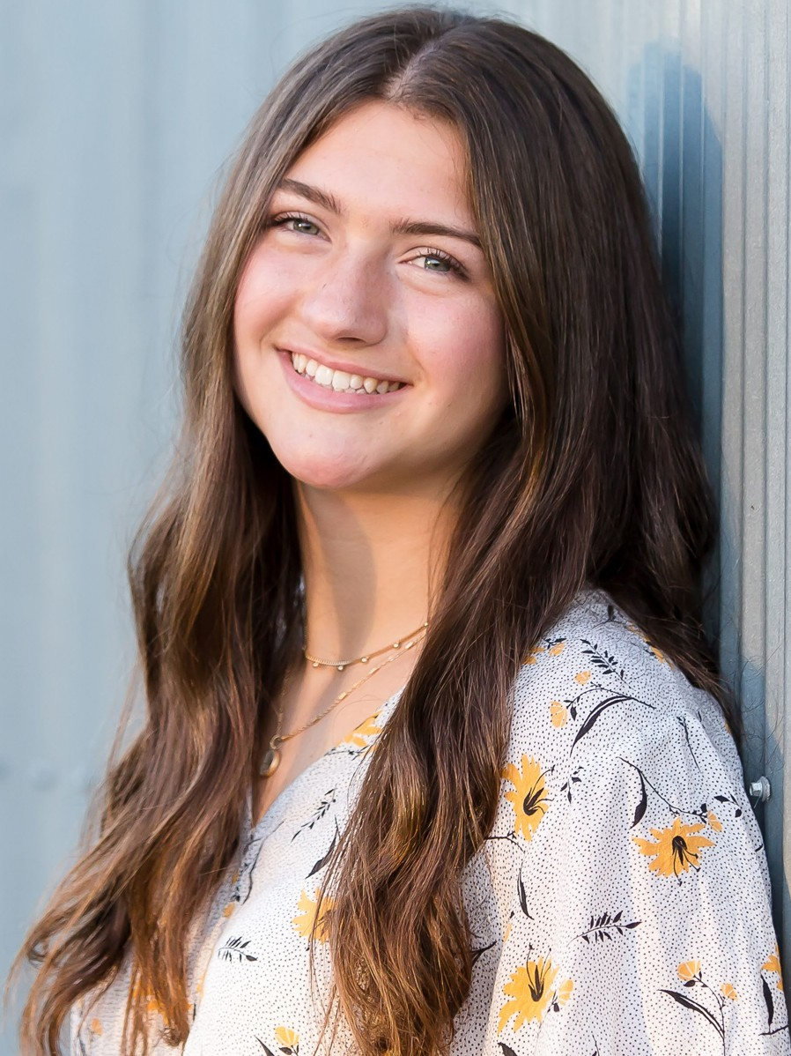
Anders Roback sang in Cantemus, Vivace, Da Capo, Luminos, Chamber Singers, and Concert Choir. He also performed in OnStage and was active in NHS, NSHS, Student Council, track, and cross country. His favorite performing arts memory is being involved in OnStage his junior year.
Julia Schorn sang in Cantabile, Cantabile Chamber Ensemble, Bel Canto, Da Capo, Chamber Singers, and Concert Choir. She also participated in Tri-M Honor Society and OnStage and played varsity soccer. Julia plans to attend the University of St. Thomas to study mathematics. Her parting advice is
Anders plans to study mechanical
to live in the moment, and don’t
engineering at Gonzaga University. He advises younger
worry about what’s to come.
students to get outside their comfort zone, take risks, and try new things! Growth comes from new experiences.
Gabby Stahl sang in Cantabile, Bella Voce, and Bel Canto. She also played soccer, hockey and softball for the Dakota Hawks. Gabby looks forward to continuing her educational journey at Bethel University. She thanks her parents for believing in her and supporting her in both academics and athletics.
Frank Romano sang in Cantemus, Vivace, Da Capo, Luminos, Chamber Singers, and Concert Choir. He also performed in OnStage. Frank looks forward to studying mathematics in college. He advises younger students to learn to relax and let go, and thanks all of his teachers who have a passion for teaching and creating
a positive learning environment.
Joshua Stalsberg sang in Cantemus and Vivace and especially enjoyed singing in the choir concerts. He was also active in his youth group. Joshua plans to
Keilani Sandkamp sang in Cantabile, Cantabile Chamber Ensemble, Bel Canto, Da Capo, Aurora, and Concert Choir. She was also in Tri-M and was active in RHS Theatre as a student director, a member of the tech crew, and in OnStage. Keilani plans to study computer science at Keene State College. She thanks Mr. Wahl &
attend Inver Hills
Community College. He reminds younger students not to sweat the small stuff, and thanks his parents for always being there for him and helping him with any stress he was dealing with.
Frau Sulli for always supporting her during her struggles in high school. She also reminds younger students to make friends who will support you, and to not take your time in high school for granted.
Jordan Storley sang in Cantabile, Cantabile Chamber Ensemble, Bel Canto, and Concert Choir. She also performed in OnStage, and was active in soccer and track & field.
Her favorite high school memory is being a super-fan. Jordan plans to attend the University of Wisconsin–
Eau Claire to study business
Neal Sannuli sang in Cantemus, Cantemus Chamber Ensemble, Da Capo, Vivace, and Concert Choir, and also participated in OnStage. He credits his involvement in football for teaching him toughness and tennis for teaching him grit. His favorite high school memory is his 100-yard
administration. She reminds
younger students that there will be times in life where you only have yourself and can't depend on others, so it’s important to learn to be independent and take care of yourself. Jordan thanks her mom for always looking after her and her dad for being an exemplary role model.
interception return. Neal plans to attend the University of Minnesota–Rochester. He thanks his parents for keeping him focused, Mr. Early for helping him with his tennis game, and Mr. Albaugh for making choir fun.

Slide 21
Saif Tariq sang in Cantemus, Vox Nova, Vivace, and Concert Choir. He was also active in Student Council and lacrosse. His fondest choir memory is doing Mr. A’s
Niko Tosh sang in Cantemus, Cantemus Chamber Ensemble, Vivace, Da Capo, Luminos, and Concert Choir. He was also in 9-10 State Honor Choir and performed in OnStage. Niko wants to pursue a career in business. He advises younger students to stick with choir, and he thanks his parents for
warmups in Cantemus. Saif plans to study biology/pre- med at the University of Minnesota. His advice to younger students is to listen to Mr. A, he’ll make you a better and more complete man.
encouraging to continue singing.
always supporting him and
An Thai sang in Cantabile, Cantabile Chamber Ensemble, Bel Canto, Da Capo, and Concert Choir. She also participated in OnStage, Tri-M, NHS, GNHS, speech, and debate. She will especially remember all the potlucks and rehearsals with everyone. © An will enter the pre-
Peter Toso sang in Da Capo, Chamber Singers, and Concert Choir, and also performed in OnStage. He also did soccer and track and played in Wind Ensemble, Jazz Band, Marching Band, and pit orchestra for the musical. Peter will continue his education at Luther College and
law track at Hamline University,
hopes one day to be an
pursing a major in international business and a minor in German. Her parting advice is to trust yourself and be confident! Everyone here believes in you and your abilities as a performer!
entrepreneur and business owner in the field of cars or auto mechanics. His parting advice is to do as many activities as you can and enjoy your high school experience while also focusing on your studies. He thanks his mom for pushing him to be the best person that he can be, and his dad for always being so supportive.
Aidan Tollefson sang in Cantemus, Vox Nova, Vivace, and Concert Choir. Vox Nova (sophomore year) was his favorite choir and favorite high school class. Aidan plans to attend Minnesota State University–Mankato. He advises younger students to make sure to keep their grades up
Olivia Youngberg sang in Bella Voce, Da Capo, Aurora, and Concert Choir. She was also in band (including Jazz Band and Marching Band), OnStage, Tri-M, COVE, NHS, FNHS, and FCA. Olivia
looks forward to starting college and thanks her family for reminding
her to not take life too seriously and
because it’s way too easy to slack;
and when things are hard, try and keep things in
perspective. He thanks Mr. A for being an amazing teacher and also an amazing mentor.
supporting her in everything she
Nathaniel Tosh sang in Cantemus, Cantemus Chamber Ensemble, Vivace, Da Capo, and Concert Choir, and performed in OnStage his sophomore and junior years. He plans to major in computer science and cyber security at UW–Stout.
Nathaniel’s favorite thing about choir was the enjoyment he felt
does. She advises younger students to remember that there is more to high school than grades, so try new things and get involved in different activities.
Jake Zimmer sang in Cantemus, Vivace, and Concert Choir, and was also involved in DECA, baseball, and basketball. His favorite choir memory is singing at the Homecoming football game his junior year. Jake plans to study business at the University of St.
Thomas. He thanks his parents for
every day walking into class, and
despite the rough year everyone has had, his memories of high school choir will stick with him forever. He wants younger students to know that choir is really a spiritual thing that brings light to many people's lives, and no matter what choir you’re in, it’s a fun experience. So stick with it; you won’t regret it.
always supporting his academic
goals. To younger students, he says, “Cherish every
moment of high school, because it will be over before you know it.”

Slide 22
Video
Senior

Slide 24
BLESSING
MAY THE ROAD
rise to meet you.
MAY THE WIND
always be at your back.
MAY THE SUN
shine warm upon your face;
MAY THE RAINS
fall soft upon your fields,
and until we meet again,
MAY GOD HOLD YOU in the palm of His hand.

